Slide 1
Together against Human Trafficking
Ninna Mörner
March 10, 2017
Swedish Platform Civil Society Against Human Trafficking

Slide 2
Swedish Platform Civil Society against Human Trafficking
What we do together:
Provide and coordinate assistance to victims
Ensure and develop the quality of assistance
Collect data on contacts with victims
Discover emerging trends and create awareness
Share experiences, information and knowledge
Cooperate and have dialogues with authorities
Monitor the implementation of human rights

Slide 3
What we can provide
Identification: Out reach work and encounters with potential VoT, guidance to help
First assistance: food, a place to sleep, social meeting places, clothes, medical care
Support to VoT: shelters, legal advices, guidance and information, interpretation, therapy
Long term assistance: rehabilitation, help to integratation, contact home countries, new start
Filling in the gaps: to ensure that VoTs recieve the rights they are entitled to

Slide 4
National Referral Mechanism (NRM)
National Coordinators Office against Prostitution and Trafficking at the County Administrative Board of Stockholm initiated 2014 a NRM-process in cooperation with the International Centre for Migration Policy Development (ICMPD), The Civil Society Platform against Trafficking and the members of the National Task Force against Prostitution and Trafficking (NMT): The Prosecution Authority, Policy Authority, Migration Agency, County Coordinators and Social services. The Ministry of Justice and Ministry of Social Affairs have been involved in the process as well.
In 2016 the NRM was launched and now joint efforts are made to spread it and implement it.
Notes:
In 2014 the National Coordinators Office against Prostitution and Trafficking at the County Administrative Board of Stockholm initiated a process in order to set up a Swedish National Referral Mechanism (NRM) in 2014 finalizing the work in April 2016. The NRM aims to improve referral as well as increase the protection and assistance of victims of trafficking. Sweden has conducted the NRM-process in cooperation with the International Centre for Migration Policy Development (ICMPD), The Civil Society Platform against Trafficking and the members of the National Task Force against Prostitution and Trafficking (NMT): The Prosecution Authority, Policy Authority, Migration Agency, County Coordinators and Social services. The Ministry of Justice and Ministry of Social Affairs have been involved in the process as well.

Slide 5
The Swedish NRM is a manual
The Swedish NRM is clearly stating the responsibilities of each authority regarding the referral of victims of trafficking.
The Regional Coordinators function as a national focal point and first point of contact for operative support in cases of trafficking.
The manual is divided into five steps, aimed to help professionals and NGOs after they have identified a presumed victim of THB
Step 1 – Identification;
Step 2 – Initial support and protection;
Step 3 – Long-term support and social inclusion;
Step 4 – Return;
Step 5 – Criminal proceedings.
Notes:
The Swedish NRM is a manual which was launched in April 2016, clearly stating the responsibilities of each authority regarding the referral of victims of trafficking. The Regional Coordinators function as a national focal point and first point of contact for operative support in cases of trafficking. The manual is divided into five steps, aimed to help professionals and NGOs after they have identified a presumed victim of THB: Step 1 – Identification; Step 2 – Initial support and protection; Step 3 – Long-term support and social inclusion; Step 4 – Return; Step 5 – Criminal proceedings. The NRM-manual is operative in its form and consists of approximately 50 pages. It is based on Swedish legislation and on operative experiences from authorities identifying victims.

Slide 6
Civil Society fills in the gap
In 2015, the County Administrative Board of Stockholm initiated a pilot National Support Programme (NSP) for victims of trafficking as a part of a governmental assignment.
The NSP is carried out by the Swedish Civil Platform. It runs parallel to the support measures offered under the Transnational Referral Mechanism and parallel with the Return Programme.
The NSP aims to provide an improved and additional support for victims of trafficking and address the needs of persons who fall in the gaps of the official system or who do not want to contact the authorities or return to their home country.
Notes:
In 2015, the County Administrative Board of Stockholm initiated a pilot National Support Programme (NSP) for victims of trafficking as a part of a governmental assignment. The NSP is carried out in cooperation with the Swedish Civil Platform and is intended to run parallel to the support measures offered under the Transnational Referral Mechanism and run parallel with the Return Programme. The NSP aims to provide an improved and additional support for victims of trafficking and address the needs of persons who fall in the gaps of the official system or who do not want to contact the authorities or return to their home country. The NSP makes it possible to offer a maximum of 30 days of services to a person while they make the decision of whether or not to contact the authorities.

Slide 7
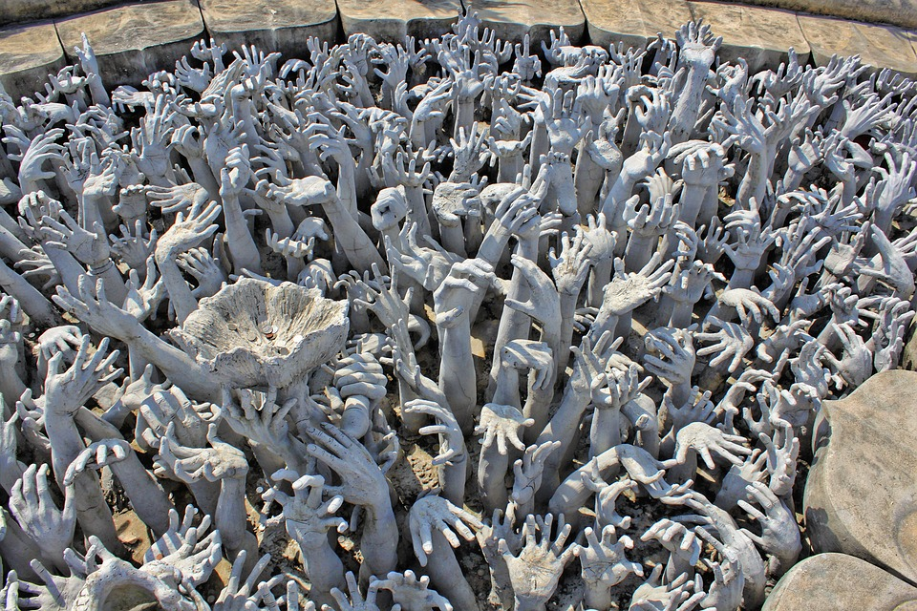
Many need a helping hand

Slide 8
Human right approach
Human trafficking is a violation of human rights
Victim first principal is our guide line
The European Council convention and the EU directive clearly states the right for all victims right to protection and assistance.
The Platform strive to jointly monitor and facilitate the full implementation of international HR-documents concerning human trafficking, ratified by Sweden

Slide 9
GRETA monitors the implementation
The convention is ratified by 40 countries
Sweden’s nine urges:
Action plans (budget, interdependent evaluation) 8/40
Training of relevant professionals 3/40
Identification of victims 32/40
Victim assistance measures 33/40
Provision of support delinked from co-operation with law enforcement 18/40
Recovery and reflection period 34/40
Child victim identification, services and legal guardian 36/40
Non-punishment provision 17/40
Investigation, prosecution and convictions 18/40

Slide 10
Findings from contacts with victims
Many victims do only contact NGOs
The VoT comes mainly from Eastern Europe and Nigeria, besides Sweden (internal).
Victims from third countries seldom report to the police, for several reasons
Asylum seekers can be former victims
Victims are vulnerable in many ways
There is a clear gender dimension
There is a high risk for re-trafficking

Slide 11
More findings: the children
The victims' children are at risk
Having children make victims vulnerable

Slide 12
National Support Programme NSP
NSP is filling in the gaps in the NRM
NSP is securing the quality of the service providers and also structure the assistance given
NSP is faciliating the entry to the NRM, after identification and before reporting to the police
NSP is aiming to secure that all victims recieve the assistance and protection they are entitled to

Slide 13
NSP. The informal NRM 2017
Informal identification by certified service provider – confirmed by programme
If not reporting to police: 30 days of de facto recovery period
If still not reporting to police; 90 days of assistance
If reporting to police and get access too the official NRM - still filling in gaps.
If not returning through official Return Programme two alternatives: - programme faciliate integration. - programme faciliate return through our network

Slide 14
Result of NSP 2016
Support is given to potential VoT delinked from cooperation with law enforcement demands
Implementation of a recovery period for 30 days
Support to VoT and also to their children
Support to VoT regardless of co-operation in law enforcement
Improved quality of the assistance given
Increase of individuals reporting with confidence to the police
IN SUM NSP IS CONTRIBUTING TO MEET GRETAs ”urges”.

Slide 15
Encountered challenge
Identification of victims for all forms is needed, as well as assistance to all groups
We cannot offer shelters for men and LGBT-group or entire families
VoTs exploited in another countries have hard to obtain help from the society
Cross-border cooperation is ad hoc based
Future scenarios of an increased number of people at risk
Notes:
Not new but true

Slide 16
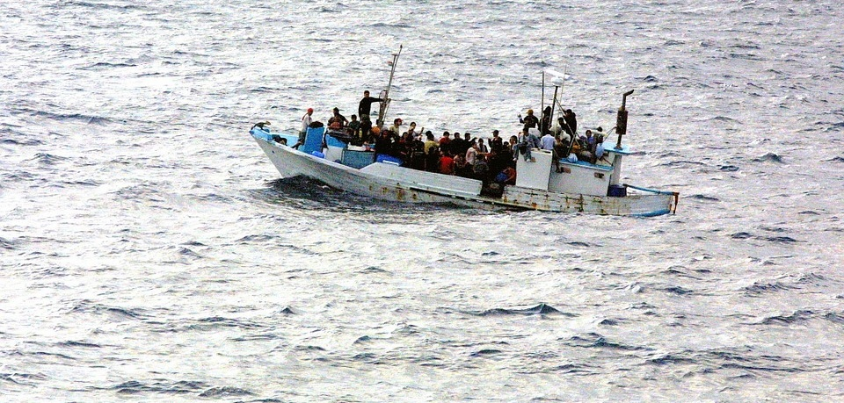
Migration & human trafficking
Notes:
The mass influx of asylum seekers in particularly in 2015 and the large number of EU migrants in Sweden have contributed to the on-going debate on the issue of vulnerability of migrants, especially women and children, to human trafficking and exploitation. There has been disturbing evidence of hundreds of unaccompanied refugee children going missing in Sweden. It has been suggested that the children could have become victims of exploitation in the country or elsewhere abroad. It is likely that human trafficking will become an increasingly acute problem in Sweden as more people in vulnerable position – both adults and children – continue to arrive and get negative decisions on their asylum claims. Worrying future scenarios include situations when newly-arrived migrants, being in a desperate need for money to pay dues to human smugglers, would end up sexually or physically exploited. In addition there are increased concerns about the vulnerability of some EU migrants to trafficking and exploitation in particularly in forced begging and labor exploitation in the berry picking sector.

Slide 17
Cooperating is the key
Overcoming competition and prejudices
Go from hinders to solutions
Jointly strive to implement the convention and directives
Continuity in work
Following-up work done
Keep the human right approach
Notes:
Victim-centered, structured and evidence based methods, dialogue and cooperation the key. We cooperate with National level
Ministry of Justice; National Rapporteur; National coordinator; Migration Board; Södertörn University; other NGOs
International level
EU-commission EU Civil Society Platform
Own networks; NGO:s other countries
Region: Council Baltic Sea States (CBSS)

Slide 18
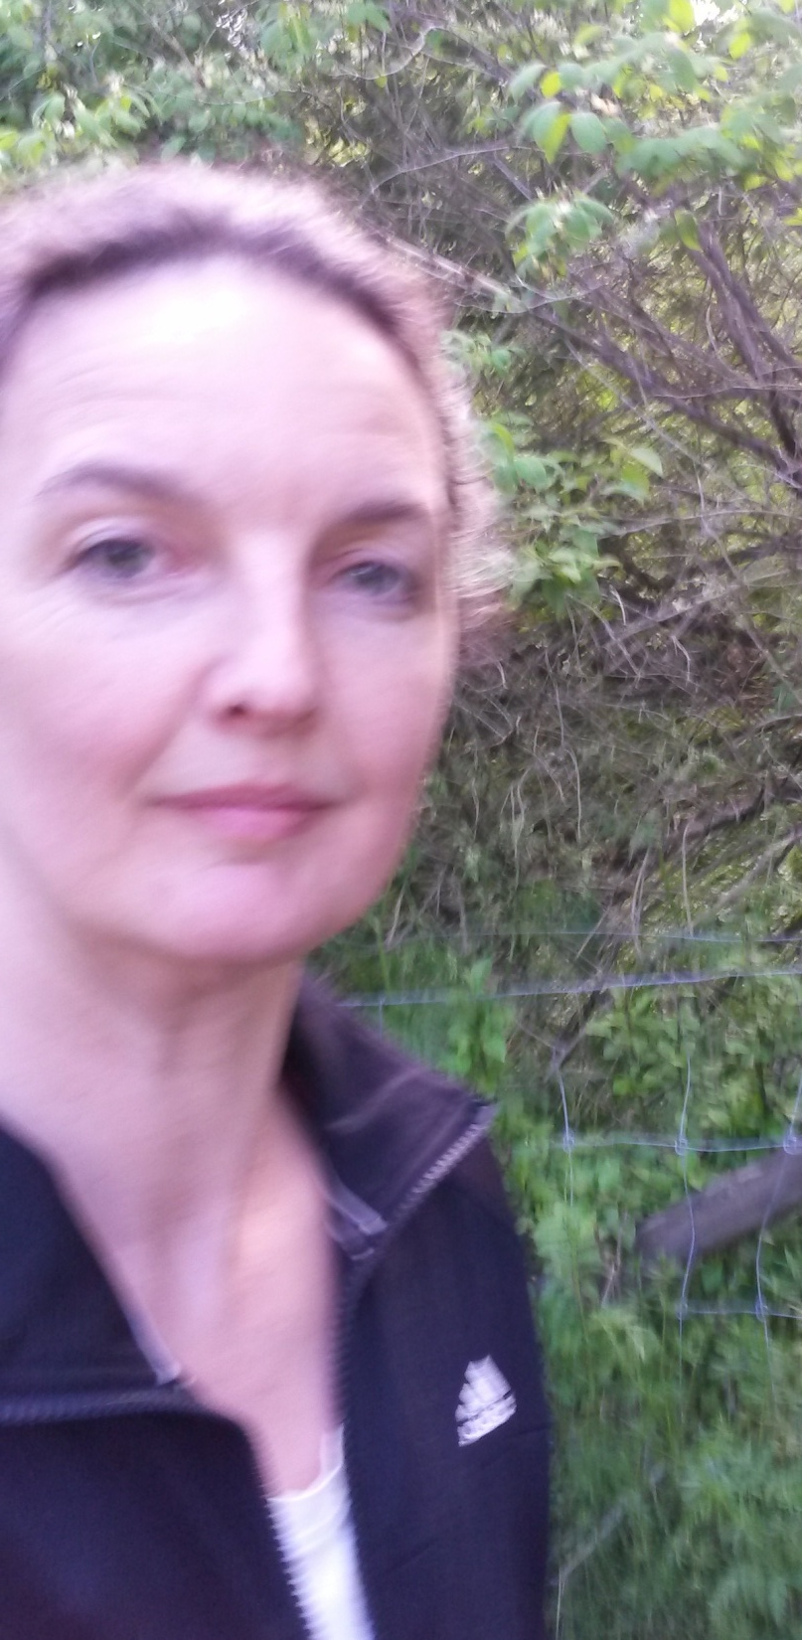
Thank you!
ninna.morner@gmail.com
www.manniskohandel.se
”Every day is a good day to fight for human dignity”

