Slide 1
Strategies to fight human trafficking: the Belgian situation

Slide 2
Introduction
1. Facts and overall trends
2. Definition
3. Coordination :
- Political coordination
- Coordination of the field players (prosecutors, law enforcement agencies, … ), criminal policy and national referral mechanism.

Slide 3
Facts and overall trends
THB in Belgium
Sexual exploitation – bars, massage parlor, hidden prostitution (internet), …
Mainly from : EU countries, asian and african countries.
Economic exploitation – restaurants, building sector, agriculture, night-shops, car-washes, domestic exploitation, meat industry, …
Not specifically “criminal networks” but “micro-structures”.
Don’t use obvious coercion means. Activities covered up by fake status (fake self-employed system for instance).
Exploitation of begging and exploitation to force victims to commit a crime occurs

Slide 4
number of new THB cases incoming in the prosecution offices during the year 2015
Source : Analystes statistiques du Collège des procureurs généraux
 | n | %
THB Exploitation of begging | 10 | 3,34
THB : sexual exploitation | 151 | 50,5
THB : economic exploitation | 124 | 41,47
THB : forced criminality | 14 | 4,68
TOTAL | 299 | 100

Slide 5
Judgements and type of exploitation – 2015
Source : Service d’appui du Collège des cours et tribunaux
Type of exploitation | cases determined (judgements)
THB - Labour exploitation | 17
THB - Sexual exploitation | 30
THB - Forced criminality | 3
 | 50

Slide 6
Trends in Belgium ?
Convicted perpetrators (2015) - 93
Source : Justice Department

Slide 7
Challenges
Identification of victims is crucial
Some field players are perfectly aware of their tasks regarding THB, others not.
This ask the question of training but also the implementation of the existing legal provisions or regulations;
huge diversity of sectors where exploitation can occur – we have cases of domestic exploitation in private households of diplomats ;
Consent or the feeling of the victim (this issue is sorted out in Belgium) ;
…

Slide 8
2. Definition
International THB definition
Classical three elements of the definition (Palermo Protocol, EU directive, …)
- action : recruiting/ transporting / transferring / harbouring / receiving persons
- by means of threat / use of force / abuse of power / abuse of vulnerability / payments (fraud, deception, … EU Directive)
- for a purpose of exploitation : sexual exploitation / forced labour or services (practices similar to servitude, slavery) / removal of organs (exploitation of begging, exploitation of criminal activities – EU directive)

Slide 9
BE definition - Art. 433 quinquies Criminal Code
the fact of recruiting, transporting, transferring, harbouring, receiving a person, and of handing over or transferring control over the said person (action):
1° for the purpose of the exploitation of prostitution or of other forms of sexual exploitation ;
2° for the purpose of the exploitation of begging;
3° for the purpose of labour or services, in conditions that are contrary to human dignity;
4° for the purpose of the removal of organs in violation of the Act of 13 June 1986 …
5° or to have this person commit a crime or an offence, against his will.
Except in the case specified under 5, the consent of the exploited person to the intended exploitation or actual exploitation is irrelevant. “
(purposes)

Slide 10
Aggravating circumstances (means)
Abuse of authority
(5/10 years imprisonment, fine up to 75 000 euros)
Victim = minor
Abuse of vulnerability
Use of force, threats or coercion means
Life of the victim was endangered
Illness or mutilation
    (10/15 years imprisonment, fine up to 100 000 euros)
Death of the victim
Criminal organisation
(15/20 years imprisonment, fine up to 150 000 euros)

Slide 11
3. Coordination
Distinction between :
- Political coordination
- Coordination of the field actions

Slide 12
Political coordination (Justice Department)
Royal decree of 16th of May 2004 (revised in 2013)
INTERDEPARTMENTAL COORDINATION PLATFORM FOR THE FIGHT AGAINST TRAFFICKING AND SMUGGLING IN HUMAN BEINGS (ICP)
Role : Ensure the coordination of the policy in matters of the fight against trafficking and smuggling in human beings
Members : All the federal actors (operational as well as political) - see next slide
Meets two times a year

Slide 13
Members (+- 22 stakeholders ) – examples :
Prime Minister, Minister of Justice (Chairmanship), Minister of Home affairs, Minister of Employment, …;
Regional Governments ;
Administrations – Federal Departments : Justice, Home Affairs, Immigration Office, Federal Police, Foreign Affairs, Employment, Social Security, Finance, … ;
Board of General Prosecutors, Federal Office of the Federal Public Prosecutor ;
Federal Centre for the Analysis of Migration Flows, the Protection of the Fundamental Rights of Foreigners and the Fight Against Human Trafficking;
Specialised reception centers for victims of THB (NGOs) – Child Focus (NGO)

Slide 14
Bureau of the ICP
Role : to ensure the daily functioning of the ICP and prepare or execute its decisions, recommendations and initiatives
Meets monthly
Members : most important actors involved in the fight against smuggling and trafficking in human beings
Federal Police, Criminal Policy Service (Justice Department), Foreign Affairs, Immigration Office, Employment (Social Inspection) and Social Security, Board of General Prosecutors and finally the Federal Migration Centre (MYRIA).
Specialized reception centers are invited at least twice a year

Slide 15
Interdepartmental Platform
Chair : Minister of Justice
Meetings : twice a year
Bureau of the ID
Chair : Justice Department
Meetings : every month
Executive organ

Slide 16
Senzitisation leaflet

Slide 17
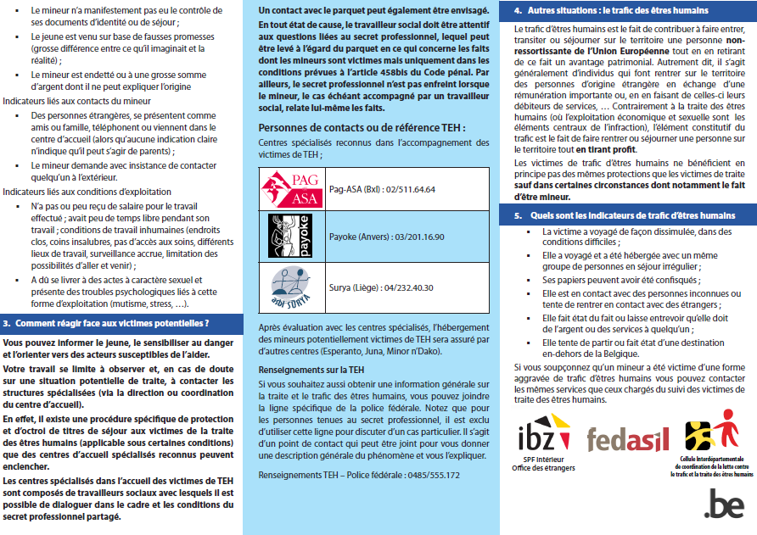

Slide 18
Coordination of the field actions
- Guideline on investigation and prosecution ;
- Multidisciplinary guideline on the referral mechanism for victims of THB.

Slide 19
Investigations and prosecutions
In order to tackle THB it is necessary to build expertise and multidisciplinary work between several stakeholders :
Law enforcement officers, social inspections, prosecutors, specialised centres for victims, administrations, …
These different players have to know how to handle a case they have to face with (procedures to follow, …)

Slide 20
(Board of General prosecutors + Justice Department)
Ministerial/General Prosecutors guideline on investigations and prosecutions of THB (Col 01/2015) – same tool regarding smuggling (Col 04/2011).
Objective : to settle and coordinate a consistent investigation and prosecution policy to combat trafficking in human beings/smuggling in human beings

Slide 21
Main elements
Specialised prosecutors in each prosecution office of the country (Labour court or ordinary criminal court) ;
Regular meetings between the stakeholders at local level (organised by the specialised magistrates) – members = Federal Police, Social Inspections, Magistrates, … (at local level – in each judicial district) ;
Data gathering and information sharing + report ;
Information on the status of victim of THB ;
Practical tools : indicator list (including specific indicators for labour exploitation), …

Slide 22
Referral mechanism and the victim’s role in the judicial procedure
Organising a referral mechansim to ensure a common way of working between the different stakeholders (identification of victims, …)
Ministerial circular of 10th of March 2017 concerning the multi-disciplinary cooperation as regards the victims of trafficking in human beings and/or of certain more serious kinds of smuggling in human beings (previously 2008)
Evaluations

Slide 23
Some measures/principles can limit the involvment of the victim in the judicial proceedings without compromising the investigation :
- Testimony not compulsory (statements can be sufficient) ;
- Associations can act as civil parties ;
- Definitive residence permit.

Slide 24

Identifying and referring (potential) victims of THB
(Potential) victim of THB
Signs/clues of exploitation observed/detected by…
Signs/clues of exploitation observed/detected by…
Bureau CICC
1. Victim identification
Police
Inspection services
Prosecutors, …
Any other field actor, frontline service (social service, doctors, guardians, …)
Either contact …
2. Information to the victim
The potential victim must be informed she/he may benefit from the assistance and support procedure
Or…
3. Information to the authorities
- Inform the specialised prosecutor
- Inform the immigration office
4. Victim referral
Contact one of the recognised specialised centers and refer the potential victim to it – When the victim is immediately referred by a frontline service to a specialised center, this takes care of informing the victim and contacting the autorithies in accordance with the guidelines set forth in the official directives.
What can be done by the specialised centers :
Phone contact 24h/24 ;
Screening of the situation by phone ;
Scheduling an appointment ;
Exceptionnally, moving of a social worker.
Specialised centers
Procedure’s continuation with the judicial authorities and the Immigration Office.

Slide 25

Granting of residence permits to the victim
Once referred to the specialised center, an interview is organised in order to assess wether or not the (potential) victim wishes to be helped and supported in the framework of the « protection procedure ». If yes, assistance will be provided and the administrative, judicial and psychosocial support begins.
Bureau CICC
5. Granting of the reflexion period
Granting of a 45 day reflexion period (45 day order to leave the territory – Directive given to the municipality after the specialised center has lodge a request by the Immigration Office)
Aim : allowing the victim to recover and decide wether or not she wants to make a statement about his/her exploitation.
Ending of the procedure if the victim does not want to make a statement
If the victim decides to make a statement or to lodge a complaint or if she has immediately made a statement without having gone through the reflexion period…
Specialised shelter
Immigration Office
6. Granting of a 3 month temporary residence permit
Granting of a 3 month duration residence permit (renewable once)
Specialised shelter
Immigration Office
Prosecutor
The « 5 questions »
May the person still be considered as victim of THB ?
Has she interrupted any contact with the presumed perpetrator ?
Does the victim collaborate with the authorities ?
Are the judicial proceedings still ongoing ?
Is there any risk in the behavior of the person which could compromise the public safety ?
During this period, on the basis of the investigation, the responsible prosecutor has to confirm wether or not the person can be considered as a victim of THB
Ending of the procedure if there is no confirmation from the prosecutor.
Prosecutor – Specialised Centre
Immigration Office
7. Granting of a 6 month duration residence permit
The ending of the procedure can happen at any stage of the procedure in specific cases such as : compromission of the public safety, non-compliance with the conditions, ...
Granting of a 6 month duration residence permit – renewable without any limit while the judicial process against the perpetrator(s) is ongoing
8. Granting of a definitive residence permit
After the perpetrator(s) has(ve) been convicted or if the prosecution office has determined the THB offence in its requisitions – a definitive residence permit (unlimited duration) can be delivered
The interruption of the support and a reorientation (shift) by the centre can also happen at different times.

Slide 26
J.-F. Minet
Barbara Vangierdegom
Ministry of Justice
General Directorate Legislation, Civil Liberties and Fundamental Rights
Criminal Policy Service
Chairman – Bureau of the Interdepartmental Platform against THB
Jean-francois.minet@just.fgov.be
Barbara.vangierdegom@just.fgov.be

