Slide 1
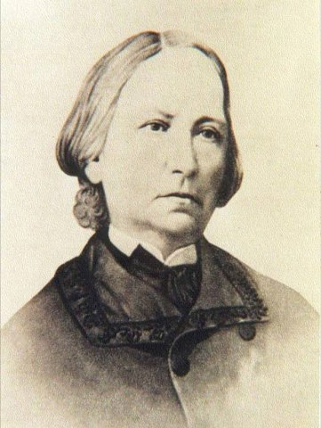
MUNICIPAL SERVICE
CONCEPCIÓN ARENAL
INTERVENTION WITH WOMEN VICTIMS OF SEXUAL EXPLOITATION
HUMAN TRAFFICKING AND PROSTITUTION

Slide 2
Concepción Arenal
Spanish writer and social activist (El Ferrol, 1820 - Vigo, 1893). She has avoided the difficulties for women to entering College. She studied Law, Sociology, History, Philosophy and languages (even going to classes dressed as a man).
She was very critical of social injustice of her century (particularly against women discrimination, workers condition and the penitentiary system).
“Everything is impossible, till it seems so”

Slide 3
MUNICIPAL PLAN AGAINST SEXUAL EXPLOITATION
Concepción Arenal Day Centre and its Mobile Unit (Outreach Programme) are part of the services included in the II Municipal Plan of Madrid Against Sexual Exploitation. Both services were created in 2004 and consolidated in 2009, when significant improvements were introduced: the joint management of both services by Madrid Council and the extension of the Mobile Unit services to weekends.
One of the main goals of the plan is to provide women in prostitution with information, support, assistance and alternatives for personal recovery and social and vocational-professional integration.

Slide 4
PROFILE OF ASSISTED WOMEN RISK FACTORS
There is not an specific profile, but there are clear risk factors:
Gender
Family
Abandonment in childhood
Unshared family responsibilities (single mothers)
Sexual abuse in the family environment
Gender violence in the family environment (collateral damage)
Forced by a family member or partner
Economic
Unemployment
Extreme poverty
Remittances
Debts

Slide 5
RISK FACTORS
Educational
Low level of education and training
Lack of access to information and services
Psychosocial
Impact of sexual abuse/ sexual assault
Addictions
Gender Violence
Low self-esteem
Immigration

Slide 6
AIMS
To promote women’s human rights through:
Total recovery of their lives and vital project.
Improving their psychological and emotional wellbeing
Supporting them through the legal and/or social process.
Providing them with tools and resources to join the labour market.
All of that, by an increasing process of empowerment leaded by them, in which women take charge of their own lives.

Slide 7
MAIN SERVICIES
The support network includes:
Outreach programme developed by the mobile unit: information, advice and support.
Specialised Comprehensive Care Day Centre
10 accommodation places for women victims of sexual exploitation and their children

Slide 8
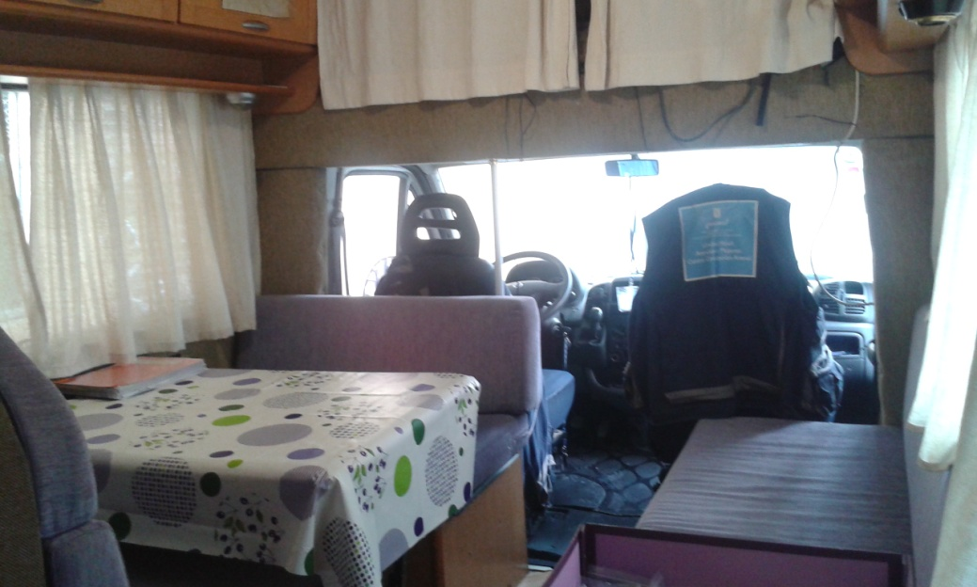
FIELD WORK: MOBILE UNIT

Slide 9
OUTREACH PROGRAMME: HOT SPOTS
The Mobile Unit visits the different prostitution sites in Madrid city, at least, once a week. It covers different hours and different weekdays in order to reach as many women as possible. It adapts the service provided to the reality and dynamics of prostitution sites.
Industrial areas:Villaverde and Vicálvaro
City centre: Montera street, Desengaño street, Jacinto Benavente square. Night shift: Paseo del Rey, Fortuny street, Capitán Haya, Fuencarral Street
Casa de Campo and Méndez Álvaro

Slide 10
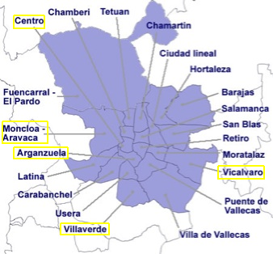
PROSTITUTION SITES IN MADRID

Slide 11
OUTREACH PROGRAMME
Aims
To be part of the «urban furniture»
To establish a trusting relationship
To break isolation/referrals and accompaniment
Crisis intervention
Coordination with Police and security forces and other social agents
To detect and Identify women who are victims of human trafficking for sexual exploitation

Slide 12
COMPREHENSIVE CARE DAY CENTRE

Slide 13
COMPREHENSIVE CARE DAY CENTRE
Goal:
To support and accompany women in prostitution or victims of trafficking for sexual exploitation throughout their recovery and quality of life improvement process.
4 INTERVENTION AREAS:
Social
Psychological
Legal
Education and Training

Slide 14
INTERVENTION MODELS
SOCIAL CONSTRUCTION OF GENDER THEORY:
Objectives and work proposals to undermine structural causes of inequality. Not just aiming to achieve prostitution abandonment but also to promote a global change in the way women see themselves, prostitution as an institution, etc.
TRANSTHEORETICAL MODEL OF CHANGE:
It provides guidance on how to promote change and transformation without imposing it. To guide change based on women’s own motivations and claims (Stage Model)

Slide 15
TRANSTHEORETICAL MODEL OF CHANGE
Avoids labels, seeks people’s acknowledgment of their behaviour or problem (non healthy habits).
Gives responsibility to women on their decision making regarding possible choices.
Acknowledge ambivalence in certain situations, behaviours, thoughts, emotions …. As something intrinsic to human nature (not pathological)
Increase motivation and promote the wish to change.
Woman as an active subject on her process and defending her rights.
Leader of her own development and responsible for her life
(Participatory methodology)

Slide 16
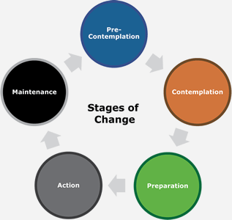
STAGES OF CHANGE Prochaska & DiClemente / Mª José Barahona
INITIAL REJECTION
FINAL REJECTION
HONEY MOON
SEEK FOR ALTERNATIVES
SURVIVAL

Slide 17
TWO TYPES OF INTERVENTION
1- Urgent intervention: activation of intervention protocols: Multidimensional.
Trafficking
Accommodation
Gender Violence
Sexual aggression
Addictions
Mental Health
2- Process Intervention (Medium-Long term)

Slide 18
MAIN INTERVENTION CHALLENGES
Urge.
Economic planning.
Social stigma.
Loss of social skills and habits.
Limited social network.
Language.
Cultural patterns.

Slide 19
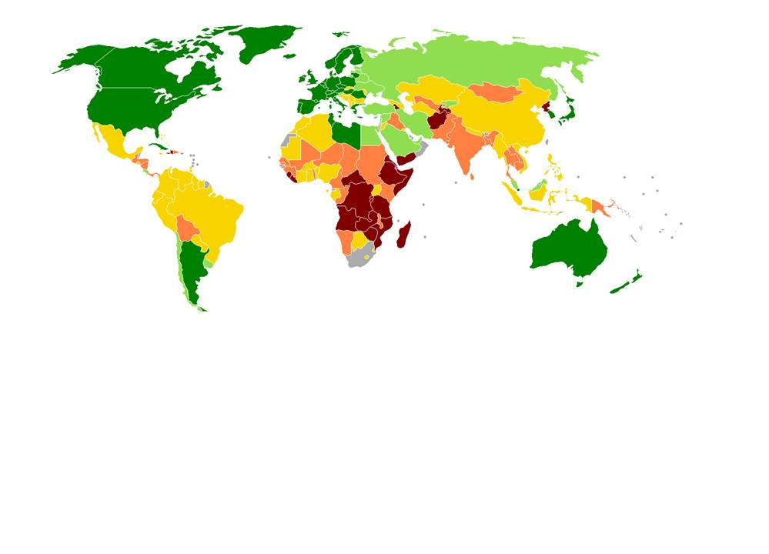
SOME SOCIO-DEMOGRAPHIC STATISTICS…

Slide 20
ASSISTED WOMEN in 2016: MOBILE UNIT & DAY CENTRE
Mobile Unit 470Women
Day Centre 409 Women

Slide 21
WOMEN’S PROFILE AGE
In the Mobile Unit most of the women are from 25 to 34 years old (32%), followed by 35 to 44 (30%), under 24 (30%)and then from 45 to 54 (14%)
In the Centre 46% of the women are from 35 to 44 years old, 29% from 25 to 34 and 14% from 45 to 54

Slide 22
WOMEN’S PROFILE NATIONALITY
In the Mobile Unit most of the women come from South America (33%), Africa (28%), Eastern european countries (24%) and Spain (13%)
In the Day Centre most women come from Nigeria (46%), Ecuador (15%), Romania (8%) and Spain (0,05%)

Slide 23
WOMEN’S PROFILE IMMIGRATION STATUS
46% of the women have Spanish or comunitarian nationality,
22% have no residence or work permit, 21% have Residence
and work permit and 8% are asylum seekers

Slide 24
WOMEN’S PROFILE EDUCATION AND TRAINING
40% Secondary school
34% Primary school
13% can read and write
5% are iliterate

Slide 25
WOMEN’S PROFILE: Day Centre WITH CHILDREN
54% of the women have dependent children

Slide 26
WOMEN’S PROFILE: Day Centre Situation in relation to human trafficking

Slide 27
MAIN WOMEN’S EXPRESSED NEEDS
In the Outreach programme, main requests are
Legal advice, health care information and training courses.
In the Day Centre most women ask for job seeking support,
Training courses, legal advice, housing advice, financial
support and psychological assistance.

Slide 28
ASOCIACIÓN TRABE SAFE HOUSE FOR WOMEN VICTIMS OF SEXUAL EXPLOTATION (Prostitution &/or trafficking)

Slide 29
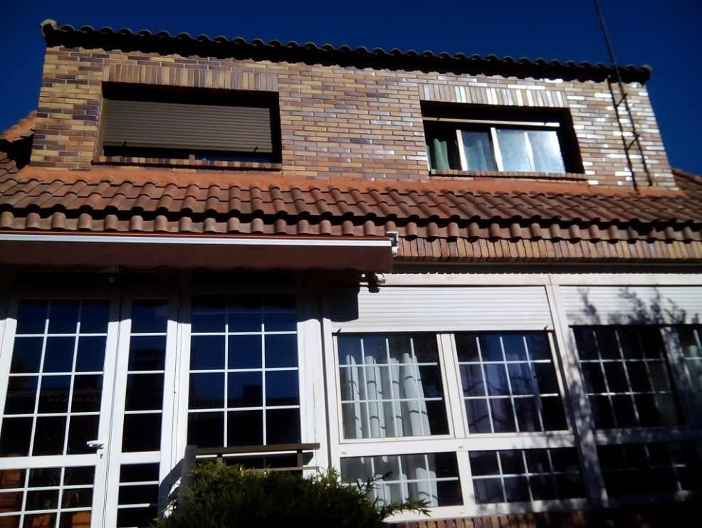
Safe House «Pandora»
It is a specialised service commissioned by City Council of Madrid for Women, alone or with children, victims of Sexual Exploitation (Prostitution &/or Trafficking).
It provides
Comprehensive care
to women and their children
who require
safe accommodation.
The shelter has a
Professional team:
Social care workers,
Psychologist and Lawyer.

Slide 30
Safe House «Pandora »
Who is the service for?
Women over 18 years of age
With or without children
Who wish to abandon prostitution or are trying to escape their exploiters
In need of safe accommodation
Willing to be sheltered
Without severe mental health issues, disabilities or substance misuse

Slide 31
Safe House «Pandora»
Aims:
To create a safe environment for emotional and physical recovery, empowerment.
To cover basic needs.
To consolidate abandonment of prostitution.
To assist women in accessing education and training , as well as the labour market.
To facilitate access to social services and other specialised services (healthcare, housing, substance misuse, etc. ).
To support women in creating social and support networks outside the prostitution environment.
Through:
Creation an development of a personal intervention plan together with each woman, taking into account their needs and claims.
Holistic approach, taking in consideration all aspects of women’s lives.
Individual work: Day to day support from all intervention areas (social, psychological and legal).
Group work: workshops, participatory activities and group therapy.
Living together based on a «Good Treatment».
Preparation for an independent living.

Slide 32
Safe House «Pandora»
Individual Work:
One- to- one weekly sessions with allocated social care worker
One- to- one sessions with the lawyer, in order to deal with legal issues.
One- to- one psychotherapy sessions
Accompaniment and support.
Liaison and coordination with other professionals involved.
Reports and referrals
Group work:
Weekly meetings: a time to discuss home issues and make proposals
Workshops on several matters, depending on women´s requests, detected needs and relevant topics from all different intervention areas: Social, Psychological and Legal.
Some topics: Social skills, Spanish, English, job seeking skills, self- defence, sexual education, labour, human and women’s rights, grief, anxiety, gender violence, romantic love, sexual education, IT , etc.
Group activities in order to improve relationships among residents, improve negotiation and communication skills, assess group roles and detect living together needs.
Some activities: Sports, handcrafts, film/TV show viewing and ulterior discussion, cultural visits, etc.

Slide 33
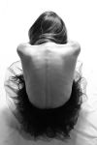
Safe House «Pandora»
Other tasks:
Working together: coordination with other services and professionals
On-going professional training
Raising awareness
Example: Exhibition “Opening the House of Pandora”: A photography project developed in Pandora´s house, to promote empowerment, equality and awareness through portraits of both workers and women living in the safe house.

Slide 34
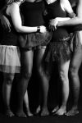
Safe House «Pandora»

Slide 35
Safe House «Pandora»
Keys to comprehensive intervention:
Methodology based on 2 theories: “Social Construction of Gender» & «Transtheoretical model of change»
Empowerment and give women encouragement to take charge of their own process
Systematic data collection and analysis
Liaison with other professionals & Team Work
Reflective practice and evaluation
Clinical supervision (individual & group supervision)

Slide 36
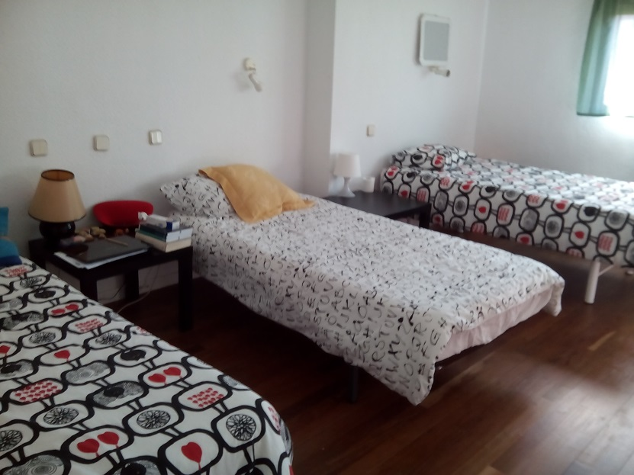
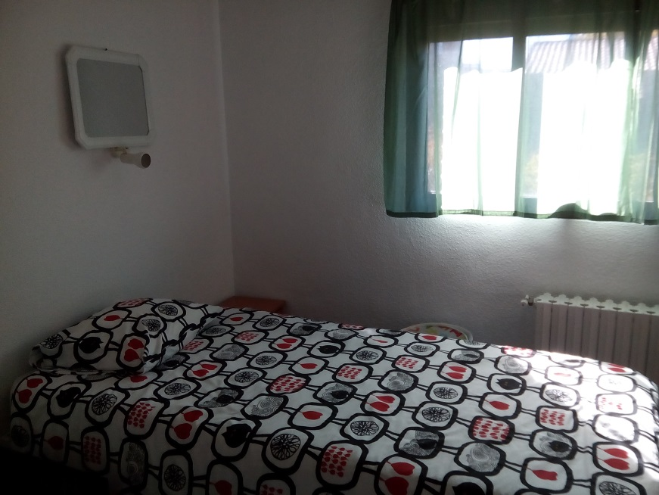
Safe House «Pandora»
“Pandora” can take in a maximum of 10 people (including children) in its 4 shared bedrooms: 2 rooms for 2 people and 2 rooms for 3 people:

Slide 37
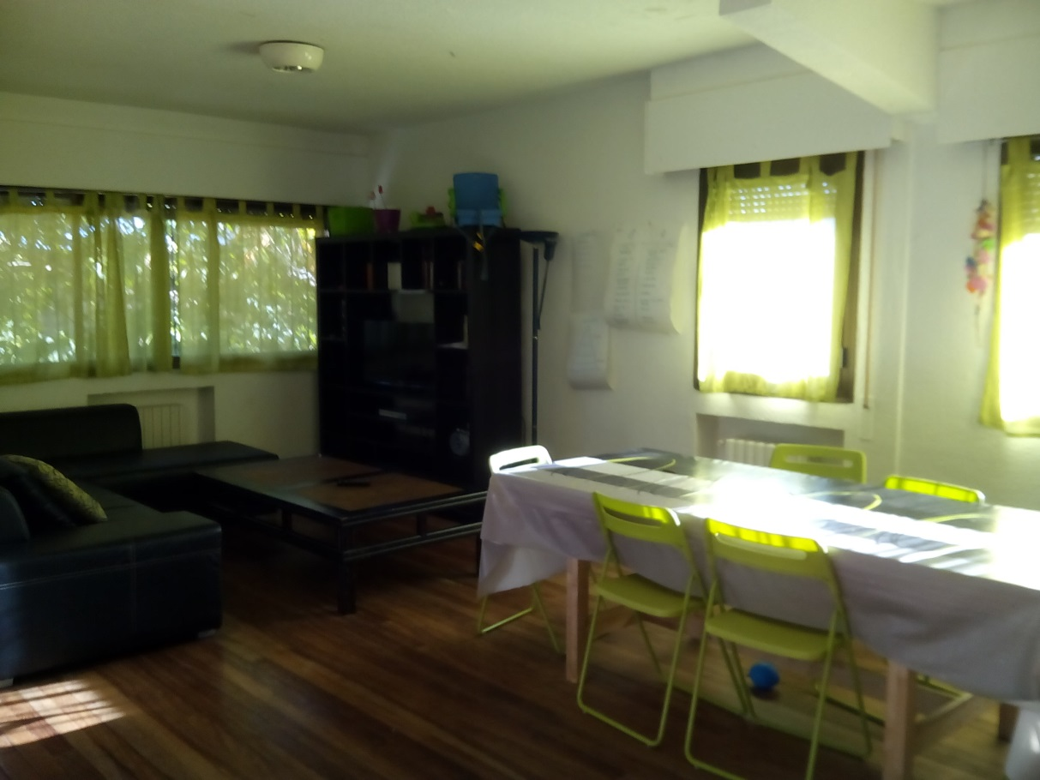
Safe House «Pandora»
The living room: a common area to share and build up relationships based on respect, good treatment, empathy and mutual support.

Slide 38
Safe House «Pandora»
“Pandora” can take in a maximum of 10 people (including children) in its 4 shared bedrooms: 2 rooms for 2 people and 2 rooms for 3 people:

Slide 39
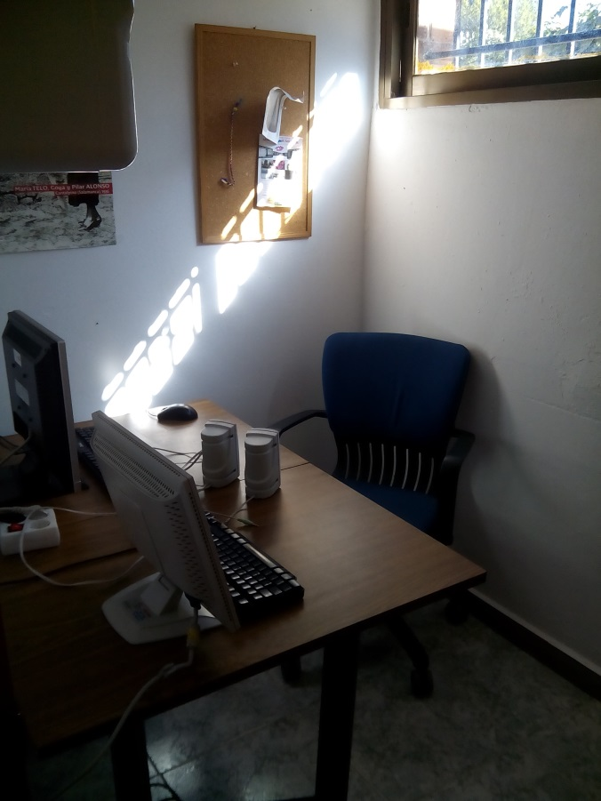
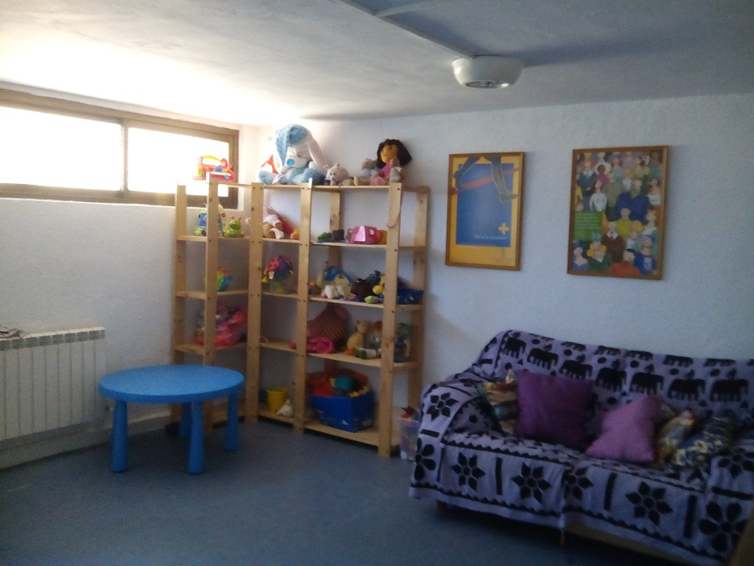
Safe House «Pandora»
There are common areas to carry out workshops and leisure indoor activities, playroom and computer room.

Slide 40
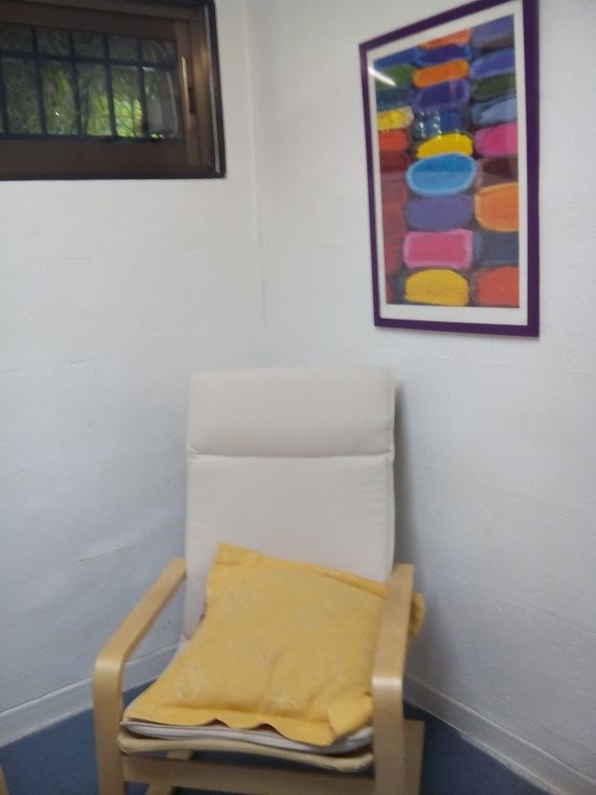
Safe House «Pandora»
24 hours service, 365 days a year. There is always, at least, 1 professional in the accommodation.
The house also has an office and an interview room, where individual interviews and meetings are conducted.

Slide 41
Safe House «Pandora»
Women stay can last up to 12 months
Intervention structured in 4 phases:
Initial Assessment: referral reception, assessment of needs, appropriateness of the service to meet those needs, etc.
Reception: settle in, link to local services, create a positive bond, reflect on own wishes, develop communication and living together skills, etc.
Develop and increase work competencies and other skills: Education and training, sharing experiences, etc.
Preparation for an independent living: entitled allowances, employment, savings plan, housing, etc.
Evaluation and follow up: joint work with “Concepción Arenal” allocated social worker and any other professionals involved.

Slide 42
CHALLENGES
Detection Vs Identification of victims
Mental Health: specific programs for women victims of human trafficking with severe mental health issues or disabilities.
Accommodation:
Emergency shelter: short-term accommodation
Transitional housing/ semi-independent living

Slide 43
CHALLENGES
Underage victims of sexual exploitation
Who they are
Where they are
How laws protect them
Support network for underage victims

Slide 44
THANK YOU VERY MUCH FOR YOUR
ATTENTION

