Slide 1


Slide 2
NOOMi
NOOMi
Korttidsboende för kvinnor över 18 år som utnyttjats i prostitution och människohandel för sexuella ändamål
Tar emot i det akuta skedet innan ansvarig myndighet definierats
Tre platser för kvinnor, en plats för
medföljande barn
Skyddad adress
Non profit organization ”Hela Människan i Malmö”
The joint social work of the churches
Safe house
Transitional shelter
Outreach
Raising awareness, educating and influencing public opinion

Slide 3


Slide 4
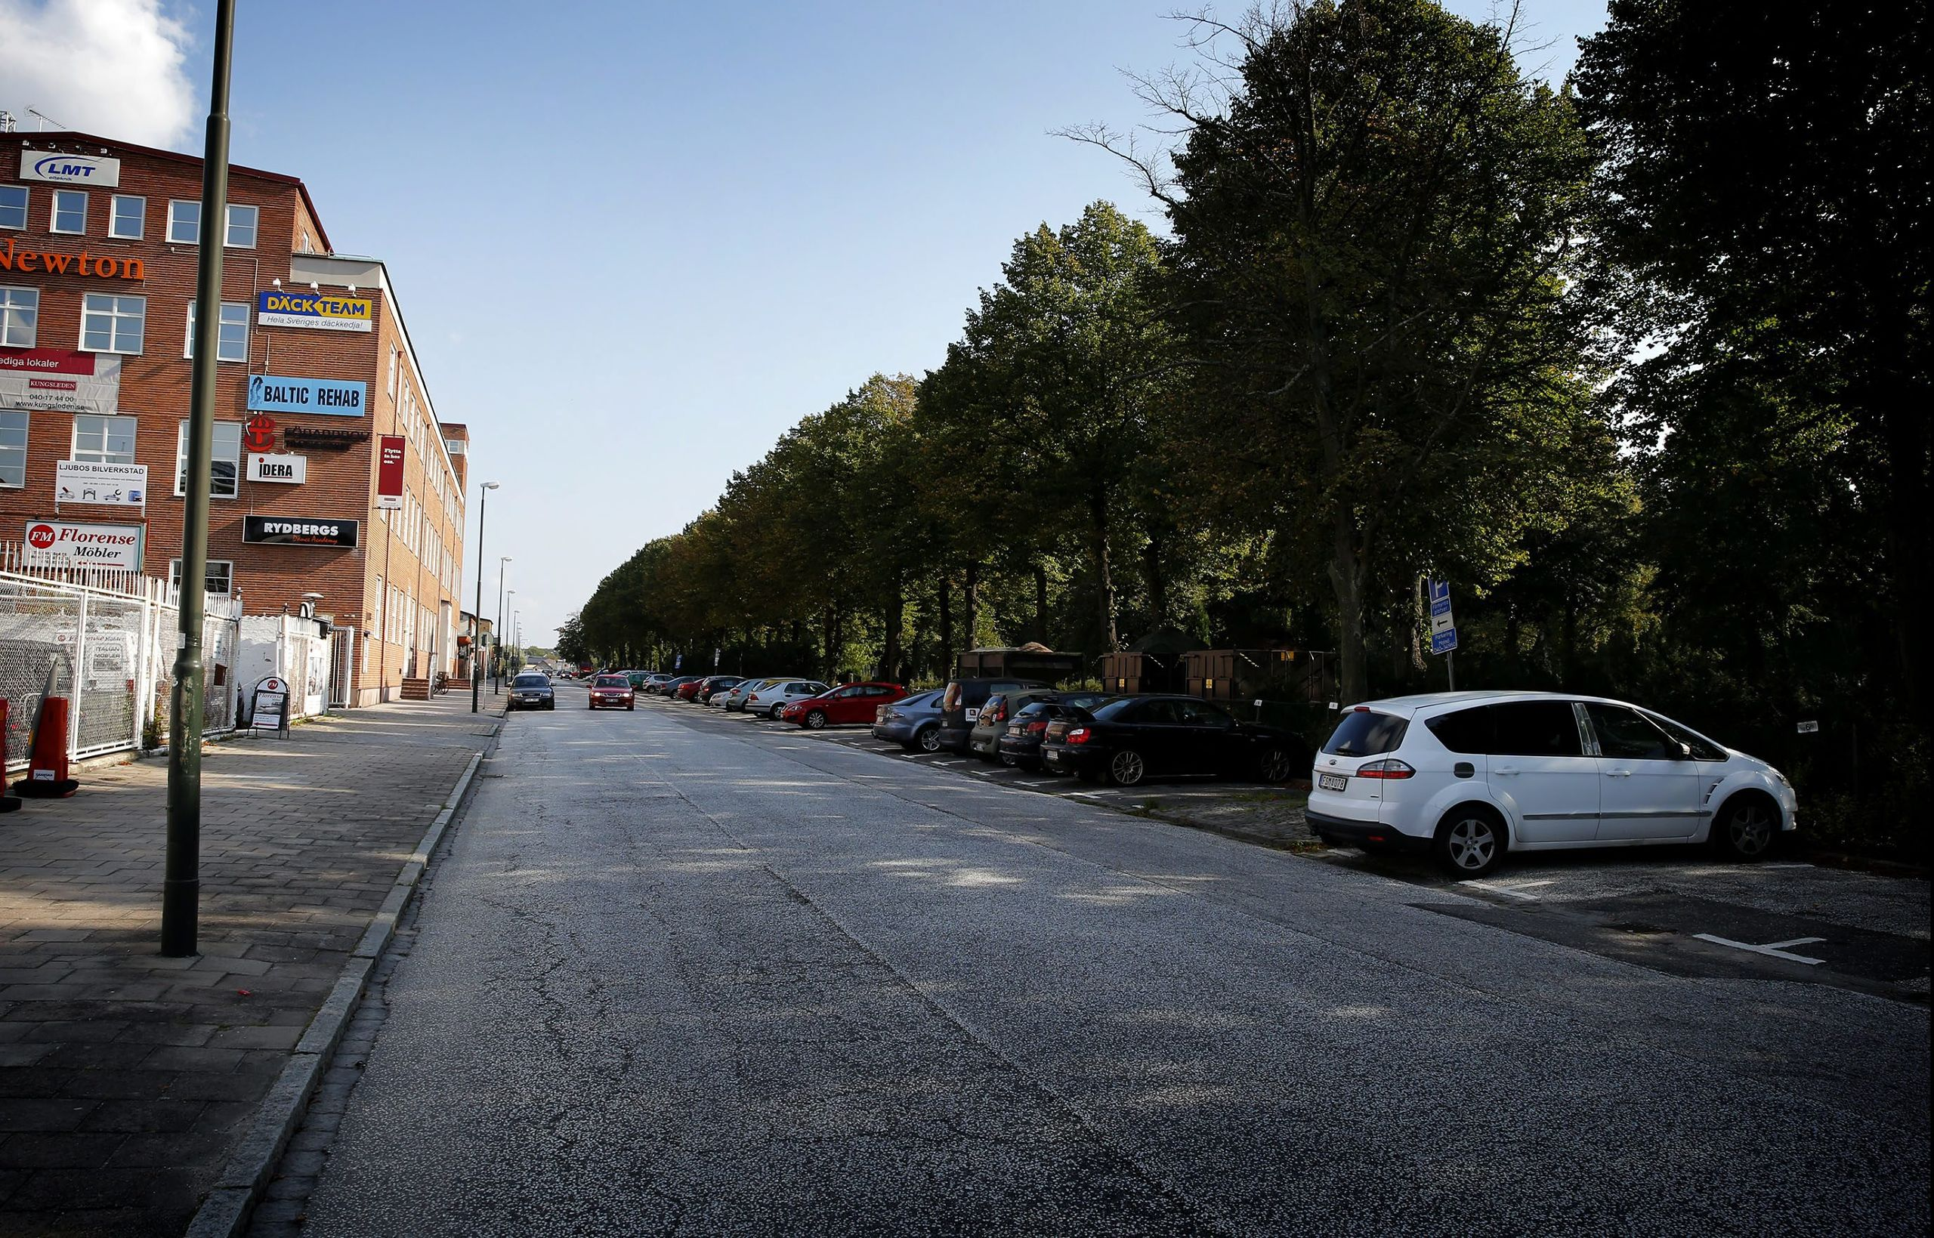

Slide 5
















The civil society´s Platform in Sweden against human trafficking
Teater ”Dream business”

Slide 6
NOOMi
Korttidsboende för kvinnor över 18 år som utnyttjats i prostitution och människohandel för sexuella ändamål
Tar emot i det akuta skedet innan ansvarig myndighet definierats
Tre platser för kvinnor, en plats för
medföljande barn
Skyddad adress
The role of the Platform
Aim to coordinate and improve the civil society´s efforts to assist victims
Compile statistics to identify needs, trends and patterns
Reports, monitors and follow up on the implementation of international conventions and directives

Slide 7
NOOMi
Korttidsboende för kvinnor över 18 år som utnyttjats i prostitution och människohandel för sexuella ändamål
Tar emot i det akuta skedet innan ansvarig myndighet definierats
Tre platser för kvinnor, en plats för
medföljande barn
Skyddad adress
National Method Support Team
Led by the County Administrative Board of Stockholm (Länsstyrelsen)
Operative network of governmental agencies cooperating
Regional coordinators
Cooperation with the Platform

Slide 8
NOOMi
Korttidsboende för kvinnor över 18 år som utnyttjats i prostitution och människohandel för sexuella ändamål
Tar emot i det akuta skedet innan ansvarig myndighet definierats
Tre platser för kvinnor, en plats för
medföljande barn
Skyddad adress
The social services of the municipality
The municipality is responsible to ensure that individuals recieve the support and help they need
The Competence Centre Sexual Services meets buyers and sellers of sexual services
Regional coordinators against human trafficking work to coordinate cases, educate and provide support

Slide 9
NOOMi
Cooperation
Korttidsboende för kvinnor över 18 år som utnyttjats i prostitution och människohandel för sexuella ändamål
Tar emot i det akuta skedet innan ansvarig myndighet definierats
Tre platser för kvinnor, en plats för
medföljande barn
Skyddad adress
Noomi intends to be complementary to the work of the social services, the Competence Center and the Regional coordinators
The Regional coordinators can direct authorities to us and offers supervision
Noomi offers housing solutions with an holostic approach

Slide 10
NOOMi
The importance of civil society
Korttidsboende för kvinnor över 18 år som utnyttjats i prostitution och människohandel för sexuella ändamål
Tar emot i det akuta skedet innan ansvarig myndighet definierats
Tre platser för kvinnor, en plats för
medföljande barn
Skyddad adress
In connection with repatriation
To add a range of assistance to the formal structures
To influence our societies

Slide 11
NOOMi
NOOMi
-Opportunity for comprehensive support
Korttidsboende för kvinnor över 18 år som utnyttjats i prostitution och människohandel för sexuella ändamål
Tar emot i det akuta skedet innan ansvarig myndighet definierats
Tre platser för kvinnor, en plats för
medföljande barn
Skyddad adress
Housing for women over 18
Secret address
Women come through governent agencies, civil society, private individuals, etc
We receive in the acute phase and can provide long-term support
Room for five women, and accompanying children

Slide 12

Bild från boendet

Slide 13
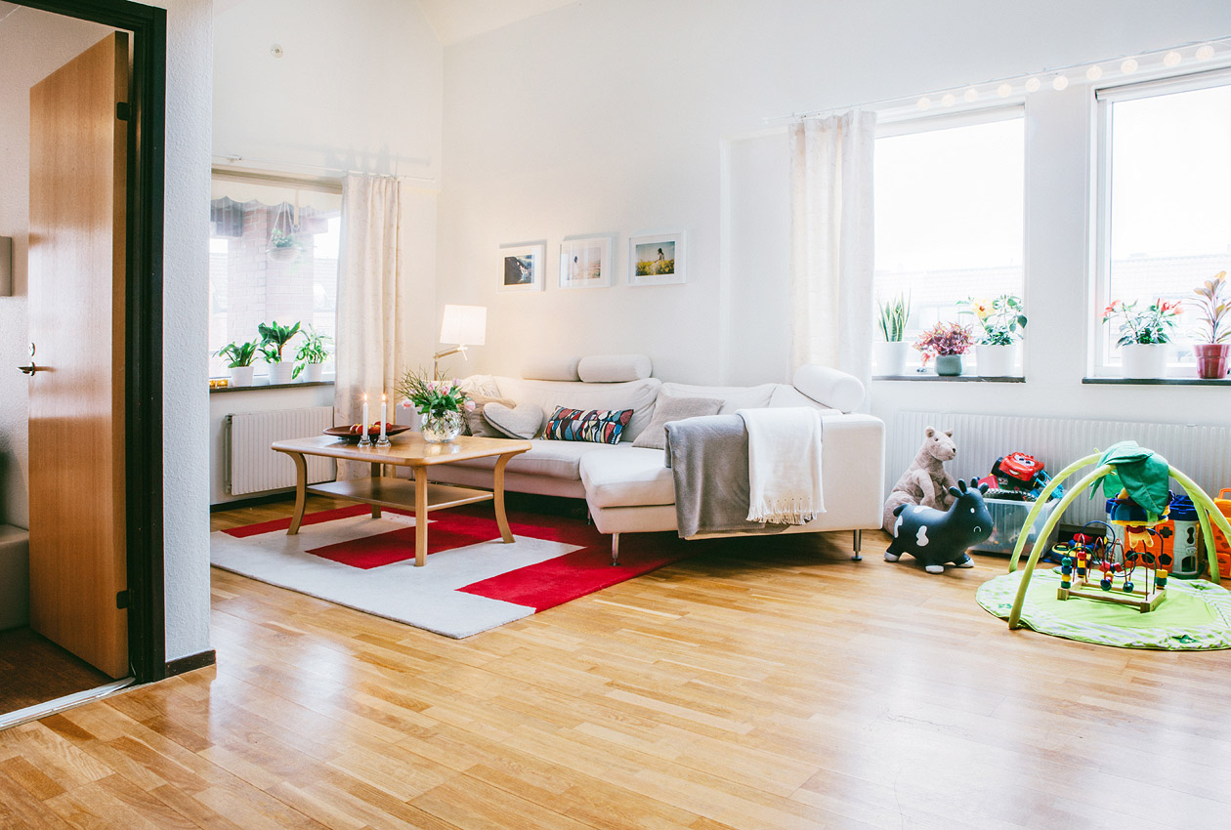
Bild från boendet

Slide 14
The civil society´s Platform against human trafficking
IOM
International Organisation
for Migration
The County
Administrative
Board
Woman at
Noomi
Police
Social services
The Migration Board
Healthcare contacts

Slide 15
Help in the acute phase
Initial risk assessment
Basic needs
Initial needs assessment
Safety plan
Thorough needs assessment and implementation plan
-What has happened?
-Needs?
-Available options?
-Wants of the woman?

Slide 16
Examples of practical help
Thorough risk assessment
Support during legal process
Fund applications
Planning for the future
Contact with relatives in home country

Slide 17
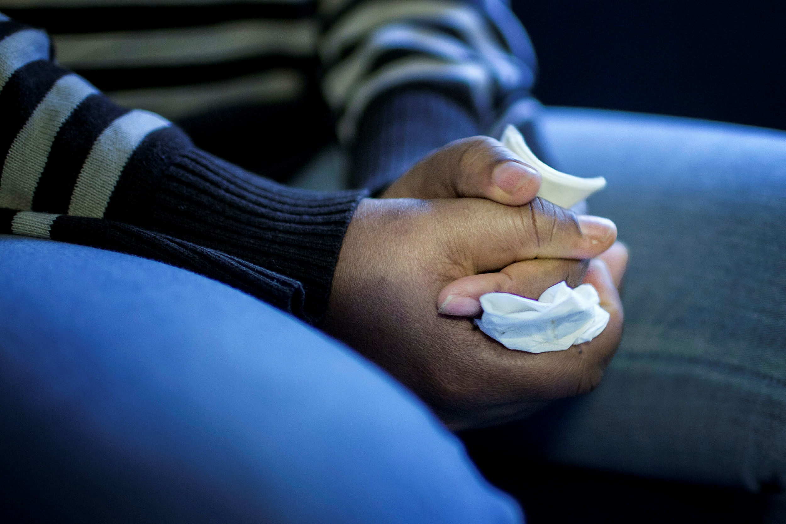

Slide 18
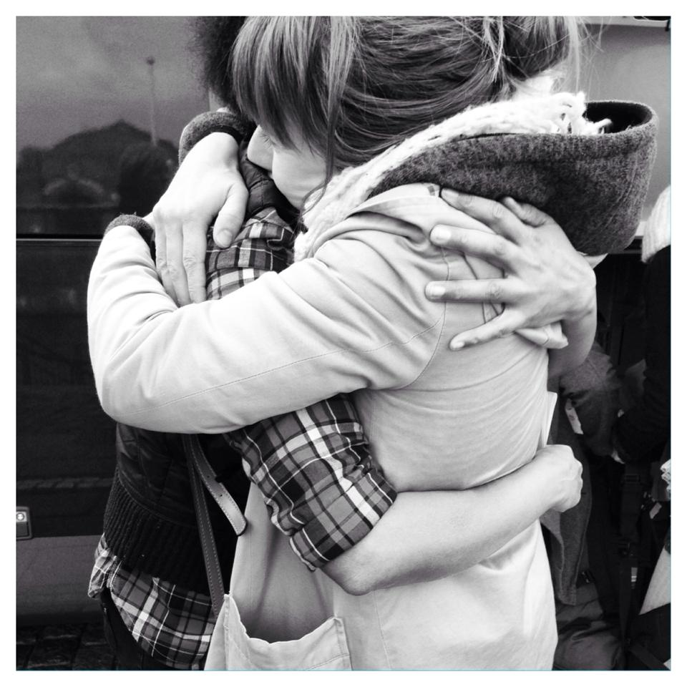

Slide 19
Support available
Depends on where the women come from
Citizenship
If the person is formally identified as a victim of human trafficking and issued a reflection period or a temporary residence permit

Slide 20
Rights
of victims of human trafficking
In accordance with the Council of Europe´s Convention victims has the right to protection and assistance like secure accommodation, material and psychological aid, legal advice
In Sweden the assistance has been made conditional
- police report
- the person in charge of the preliminary investigation can apply for a reflection period or a temporary residence permit

Slide 21
The National Support Program
The County Administrative Board of Stockholm was commissioned by the government
Developed in cooperation with the Platform
Certified actors who work in a similar way, using the same needs and assessment templates etc

Slide 22
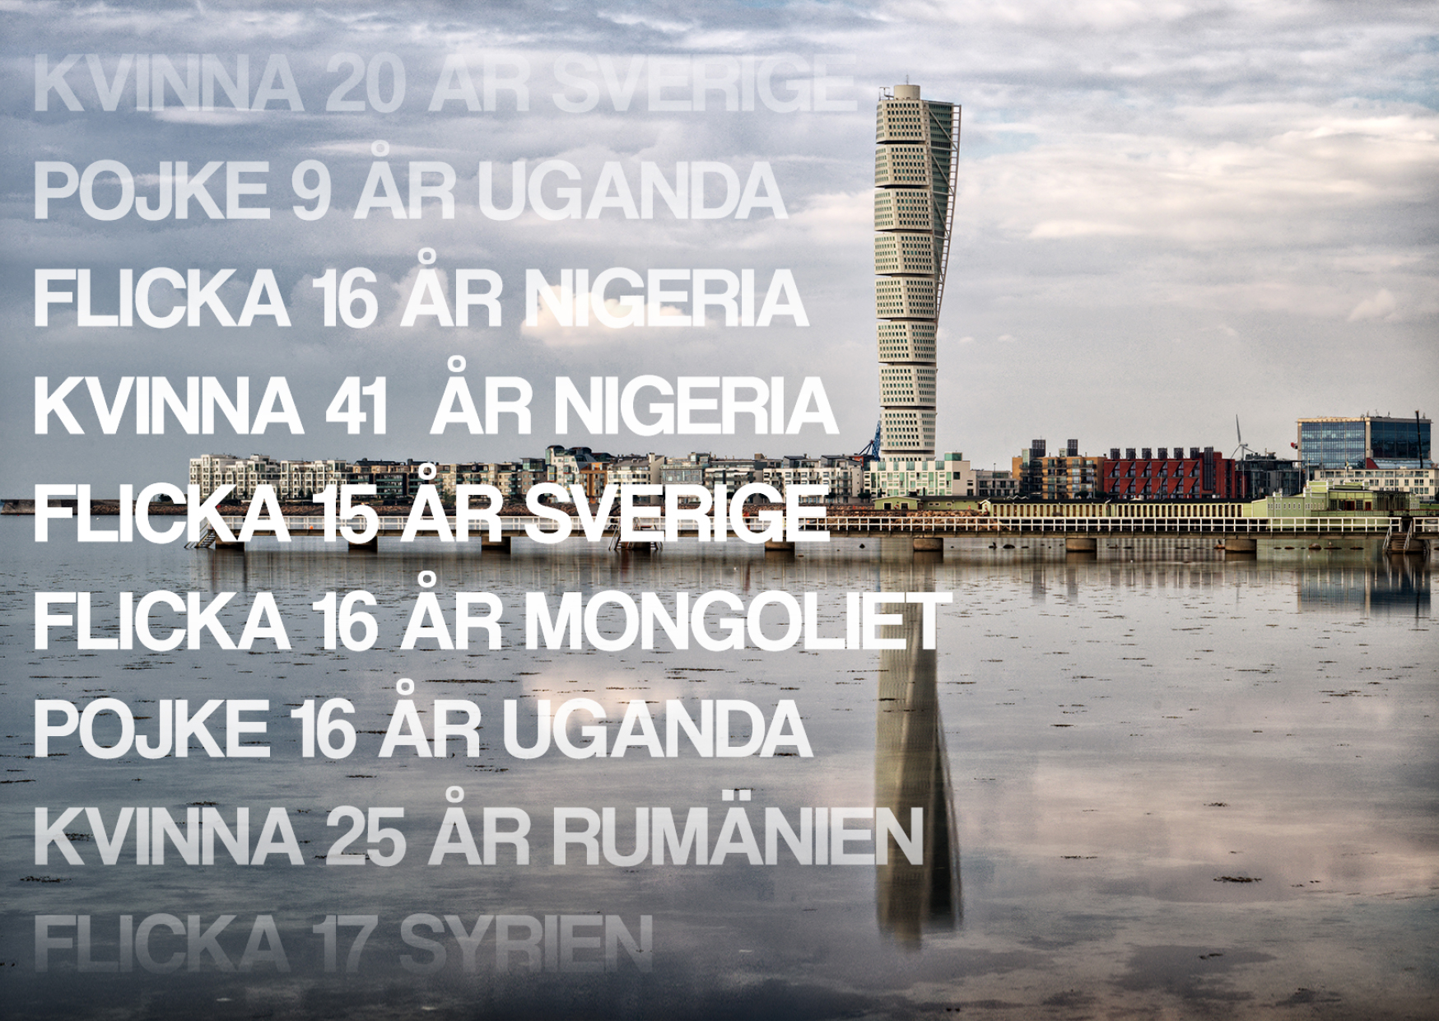

Slide 23
Transitional program
For those who can and want to stay in Sweden
Aim for her to live an independent life with economic and social security, being equal to others in living conditions and for her to have opportunities to participate actively in society.
Lessons in three areas: employment, health and life in Sweden

Slide 24
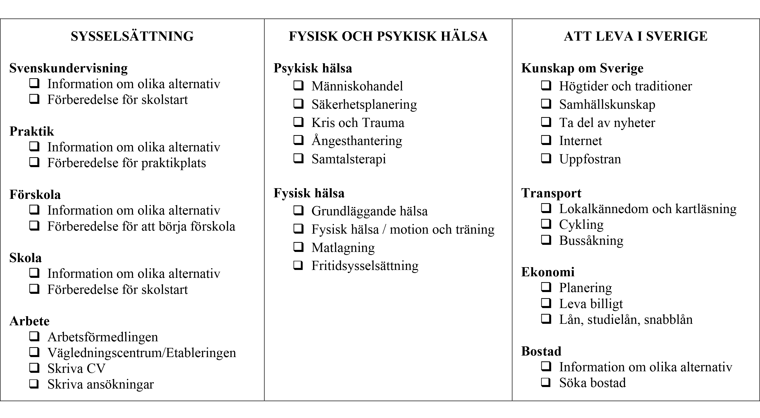
Transitional program

Slide 25
Reflection questions
Did you know what human trafficking was, before you received this information?
What are your thoughts now that you have gotten this information?
Can you see similarities between the information you received about how human trafficking works and your own life?
Do you agree with the statement that "you are a victim of very unfortunate circumstances”? If yes why, if no, why not?

Slide 26
The women had a great need of someone to talk to. They were not referring to a formal counselling session but to a personal contact from which they were able to draw strength and affirmation, to be able to cope.
“The troublesome violence” (Det besvärliga våldet)
Thesis by Veronica Ekström

Slide 27
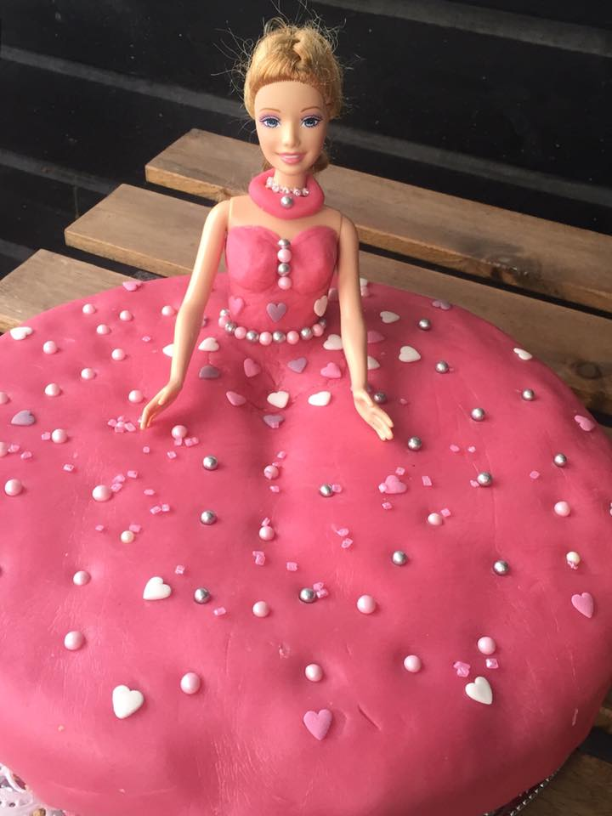

Slide 28

Contact
www.noomimalmo.se
noomi@helamanniskan.se
Phone: +46-40-63 23 521, +46-76-610 13 64
www.facebook.com/NoomiMalmo

