Slide 1

STRENGTHENING MULTIDISCIPLINARY COOPERATION TO ENSURE AN EFFECTIVE REFERRAL, ASSISTANCE, RIGHTS PROTECTION FOR VICTIMS OF HUMAN TRAFFICKING
STUDY WORKSHOP & VISIT BRUSSELS, BELGIUM
Day 1 - Brussels, 25 April 2017
Combating Trafficking in Human Beings for labour exploitation
The Belgian Social Inspectorate: role and experiences
Peter Van Hauwermeiren
director
Belgian Ministry of Social Security
Social Inspectorate
1
Notes:
1
1
1

Slide 2
Preliminarily …
Social and Labour Inspectorates in Belgium
Fragmentation
    several inspectorates
    specific + overlapping competences
    different focuses
Coordination
    umbrella service
    formal and informal
    exchange information
    ICT tools
“social inspectors”
    common denomination
    common investigative powers
    Social Criminal Code
2
2
2

Slide 3
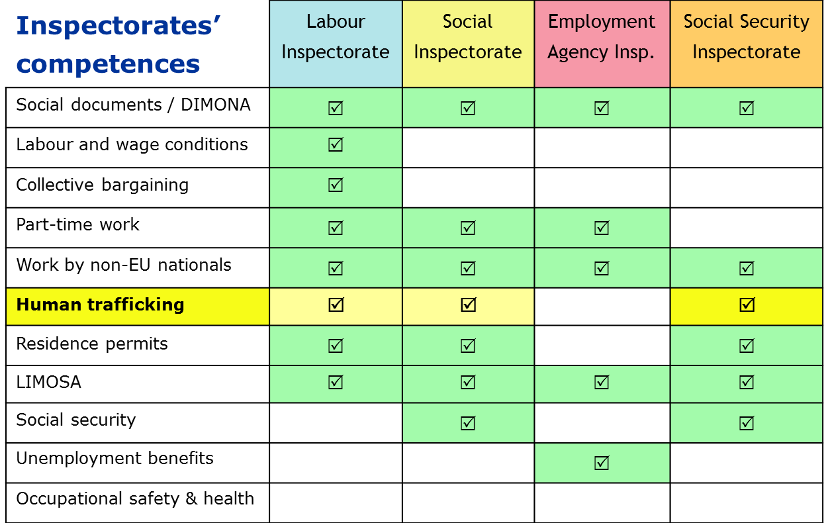
Preliminarily …
Social and Labour Inspectorates in Belgium
3
3
3

Slide 4
The Belgian Social Inspectorate’s role in the fight against THB
  Legal mandate to investigate trafficking in human beings
  not out of the blue (1990s)
    sexual exploitation at the outset
    shift towards labor exploitation → number of situations detected,
    number of cases prosecuted, number of victims assisted
  part of a comprehensive anti-trafficking policy
  labour inspectors have a role to play as frontline actors
    widely present on the field
    extensive investigating powers
    know the labour standards
investigation
DETECTION
4
4
4
4

Slide 5
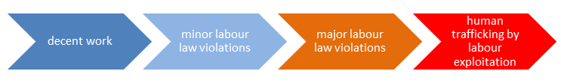
Sociale Inspectie en mensenhandel - focus
Between decent work and trafficking for labour exploitation
Reorganisation 1 July 2017:
Social Inspectorate to be integrated into the NSSO
fighting human trafficking for labour exploitation remains a focus
FOCUS SI
5
5
5

Slide 6
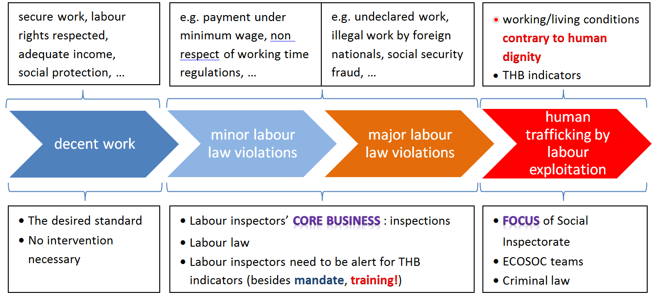
The Belgian Social Inspectorate’s focus on labour trafficking
Specialisation – Training
6
6
6

Slide 7
Belgian Social and Labour Inspectorates’ fields of competence
Powers of Belgian labour inspectors
Labour law violations
Labour trafficking
DETECTION
investigation
generalist inspectors (220)
routine inspection visits
alertness
specialized inspectors (35) (ECOSOC units)
targeted visits
network of specialized units
7
7
7
7

Slide 8
The Belgian Social Inspectorate’s focus on labour trafficking
Coordination between key partners
Victim referral centres
(Labour) Prosecutor
Social
Inspectorate
Police

Slide 9
The Belgian Social Inspectorate’s focus on labour trafficking
Coordinating mechanisms
  National level : Interdepartmental Coordination Platform
    managed by a Bureau (all relevant actors represented)
  Local level : meetings in each district
    chaired by specialised prosecutor
    all relevant actors
    at least twice a year
  Joint inspection visits ⇨ importance of local networks of key partners
    police and inspecorate
    high risk sectors
    alertness for situations below normal labour standards
  Directive from the Minister of Justice and the Board of Prosecutors General
9
9
9
9

Slide 10
# Investigations THB carried out by the Social Inspectorate
10
10
10
10

Slide 11
# Trafficking offences reported by the Social Inspectorate
11
11
11
11

Slide 12
The Labour Inspectors’ role in combating THB
Belgian Social Inspectorate - What works well?
  Specialization : units (ECOSOC) and agents
    reference persons for colleagues in their own inspectorate
    also reference persons for third parties (prosecutor, police, others)
    integrated in a network
  Networking (the multidisciplinary approach)
    formal and informal structures
    low-threshold contacts and good cooperation between prosecutors, police and labour inspectors
  Improved reporting to the prosecutor
12
12
12
12

Slide 13
The Belgian Labour Inspector’s role in combating THB
Belgian Social Inspectorate - What has to be improved?
  Victim detection by labour inspectors
    some situations/victims of THB are not adequately detected by inspectors
    too often victims are still not being referred
    too little attention to potential victims who are EU nationals
  Too often no access to compensation for victims
    in case of non-referral, civil proceedings are rarely instituted before criminal court
    in particular : victims who are EU nationals
  Training for labour inspectors should be stepped up
    permanent training to specialized agents ECOSOC units
    also basic training for non-specialized inspectors
13
13
13
13

Slide 14
The Belgian Social Inspectorate’s role in the fight against THB
  Critical success factors for effective multidisciplinary approach
    government : fight against human trafficking, including trafficking for the purpose of labour exploitation = a policy priority
    Social Inspectorate : management makes activities against labour exploitation a strategic goal and a focus activity
    labour inspectors : awareness, training and motivation
14
14
14
14

Slide 15
Social Inspectorate : investigating domestic work
Preliminary remarks on the Belgian approach
Powers labour inspectors :
  Enter any workplace freely, day and night, without prior notice
  Privately occupied premises, however :
  consent of the inhabitant
  with an authorisation for a visitation awarded by the examining judge
Domestic workers :
  Regular private households
  Diplomatic house staff : diplomatic immunity
Difficulties :
  invisibility
  isolation and high degree of dependence on employer
  hard to collect evidence
15
15
15

Slide 16
Social Inspectorate : investigating domestic work
Preliminary remarks on the Belgian approach
Diplomatic house staff
  Since 2013 : creation of a Commission of Good Practices
  Following the ratification of ILO Convention 189 on decent work for domestic workers
  Members : Labour and Social Inspectorates, Ministry of Finance, Foreign Affairs, Trade Unions
  Main mission :
  analyse conflicts, propose advice and counsel in order to find a solution in mutual agreement
  inform the Embassies about their legal duties
  launch proposals for better working conditions for the Embassies staff
16
16
16

Slide 17
Social Inspectorate : investigating domestic work
Preliminary remarks on the Belgian approach
Diplomatic house staff
  Procedure :
  plaintiff sends a letter to the Commission (or one of its members)
  case is discussed at next Commission meeting, with following result :
  official letter addressed to Embassador, or
  a friendly meeting in order to find a solution with the Embassy
  Number of cases :
  2013 : 15
  2014 : 3
  Motives of the complaints :
  dismissal without compensation for ending the contract
  moral or sexual harassment
  non declaration to Belgian social security
  non payment of overtime work
17
17
17

Slide 18
Social Inspectorate : investigating domestic work
Case
12 July 2010
  Social Inspectorate receives anonymous information
  first check on the location
  information reported to the THB prosecutor
13 July 2010: social inspector requests warrant to enter private residence
  Court order delivered to enter private rooms
19 July 2010 : inspection visit in Brussels apartment by labour inspector + 2 police – first findings / material evidence:
  Congolese woman F. – 47 years old - nanny of 2 disabled teenagers
  Passport Democratic Republic of the Congo – illegal residence
  passport F. in box in employer’s room (locked)
  F.’s personal belongings in bag and in sons’ room
  mattress under bunk bed, on the ground, used by F. to sleep on
  F. is totally exhausted
Occupants of the house : 40 y.o. Congolese woman B. (legal residence) + 2 disabled sons (16 and 18 y.o.)
18
18
18

Slide 19
Social Inspectorate : investigating domestic work
Case
During the visit to the house / intervention on 19 July 2010
  photos were taken by labour inspector to illustrate material evidence
  F. brought over to the police office
  first contact with / advice to THB magistrate
  victim wished to leave the apartment
  victim interviewed by labour inspector + female colleague inspector + police woman + woman from referral centre
F. told her story (first statements)
  arrived in Belgium on 16 November 2009
  works as a nanny for 2 disabled sons Y. and O.
  had worked for employer’s family in DR Congo before that for 9 years (last salary: 100 USD/month)
  employer moved to Belgium for proper medical treatment
  son O. needs constant care (16 y.o., 60 kgs), day and night
  she did household work too (cooking, serving, dishes, cleaning, laundry, …)
  salary : 300 USD/month promised, to be paid in DR Congo
  got paid 15 €/month since March 2010
19
19
19

Slide 20
Social Inspectorate : investigating domestic work
Case
F. told her story (first statements)
  worked 7 days/week from 7 AM to 10 PM – during the night extra care to the disabled child – no rest
  available 24/24h, 7/7d
  she had to render her passport upon arrival, it was taken from her
  had to sleep on a mattress on the ground to be near to O.
  no closet for clothes or other personal belongings
  employer shouted at F. regularly, F. always apologised
  pain in back and arms due to the hard work, could see no doctor
  no contact with her family in Congo
  no contacts/relations in Belgium at all, besides her employer
F. looked very tired, exhausted even, was in distress
During the interviewing of F., her employer called the inspector, from Kinshasa, Congo
  first denied knowing F.
  then said she was a family member
20
20
20

Slide 21
Social Inspectorate : investigating domestic work
Case
F. agreed to be referred to referral centre Pag-Asa in Brussels
  get time to reflect and maybe file a complaint
  prosecutor gave approval, Aliens Office was contacted
  20 July – 03 August 2010 : questioning of witnesses, testimonies
  nurses who came to the apartment to provide health care to O.
  extra sitters for Y. and O.
  social workers
  pharmacist
  employer’s sister
  Witnesses’ (10) statements :
  confirmed working and living conditions as described by F.
  referred to employer’s demanding/dominant and F.’s shy and submissive attitude
  F. was silent and reserved
  employer was often absent
21
21
21

Slide 22
Social Inspectorate : investigating domestic work
Case
  Employer’s statement 29 July 2010:
  F. is a friend
  F. asked to come stay in her apartment in Brussels for a while
  November 2009 – July 2010 : stay in her apartment, free of charge
  F. just did some grocery shopping, some household tasks, …
  employer herself took care of her son O., this was not F.’s task
  confronted with F.’s + witnesses’ statements : complete denial
  Report drawn up by the Labour Inspector, sent to the Prosecutor on 4 August 2010
  in due time
  precise findings
  complete (+ photos)
22
22
22

Slide 23
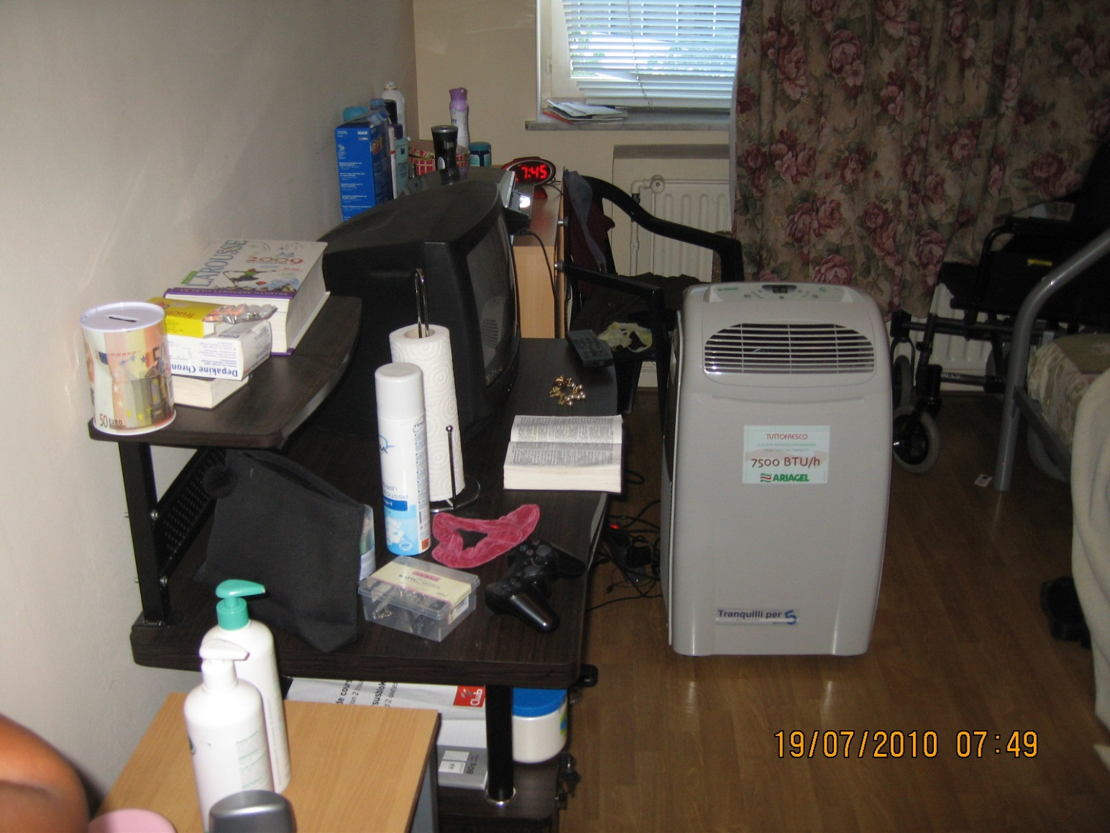
FILE “CHICOTTE” – July 2010

Slide 24
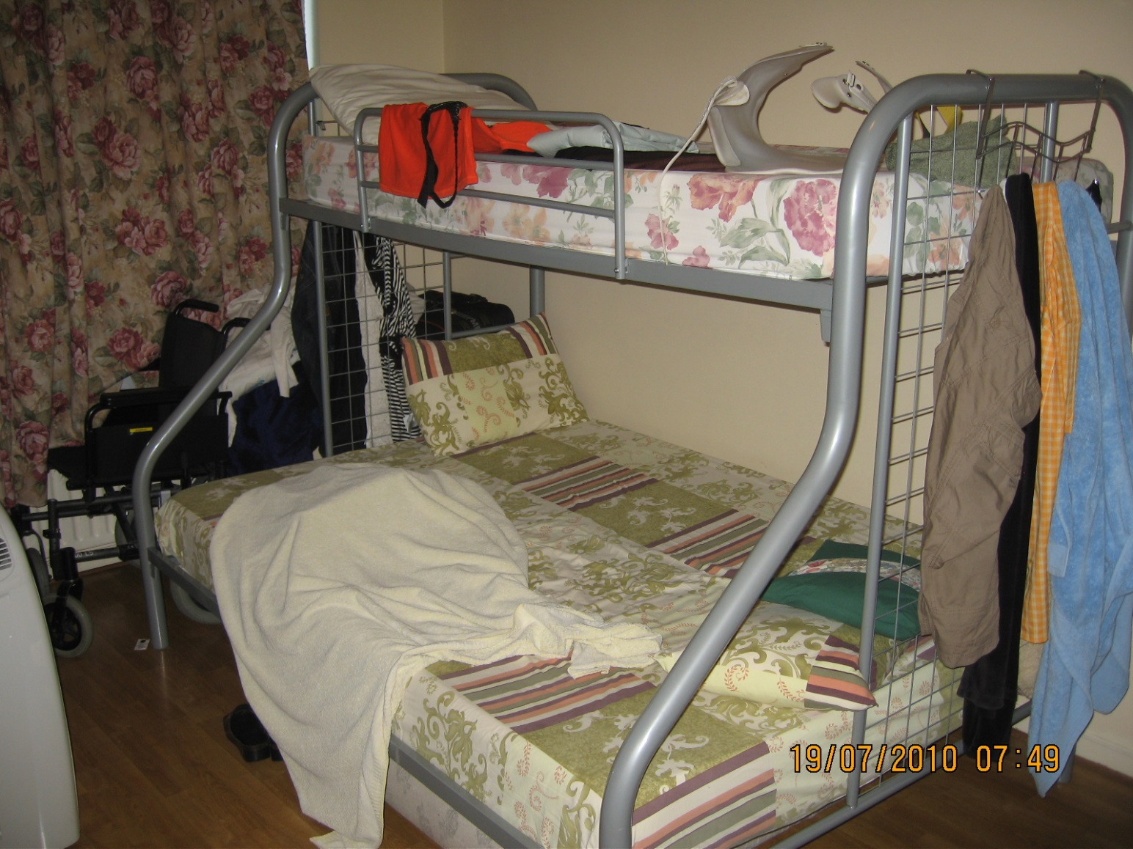
FILE “CHICOTTE” – July 2010

Slide 25
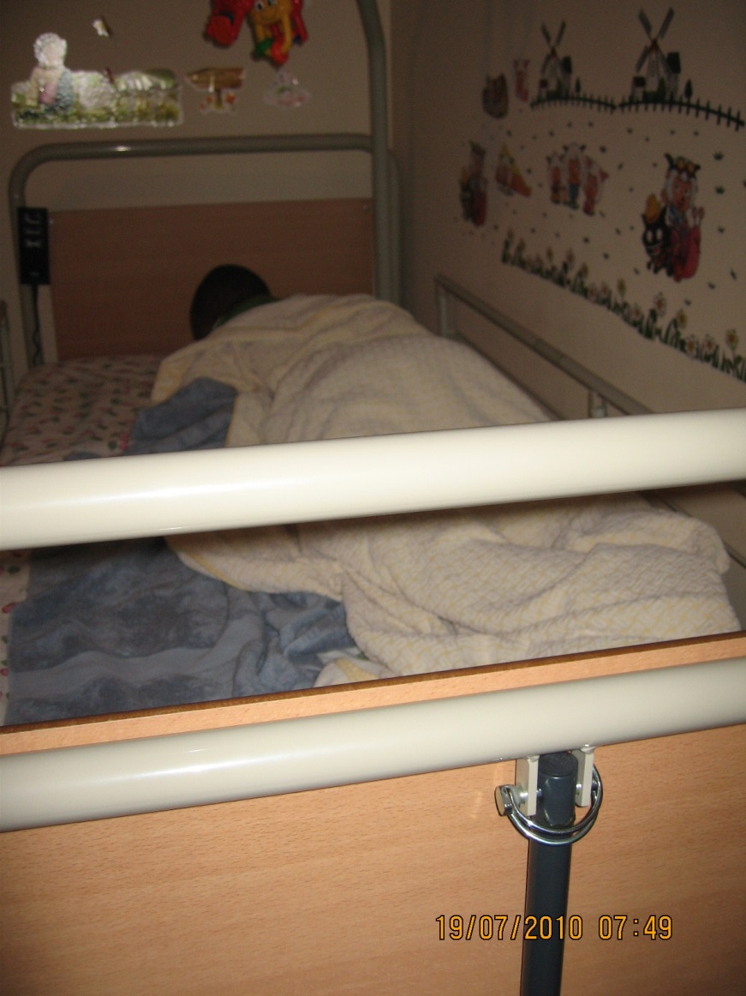

Slide 26
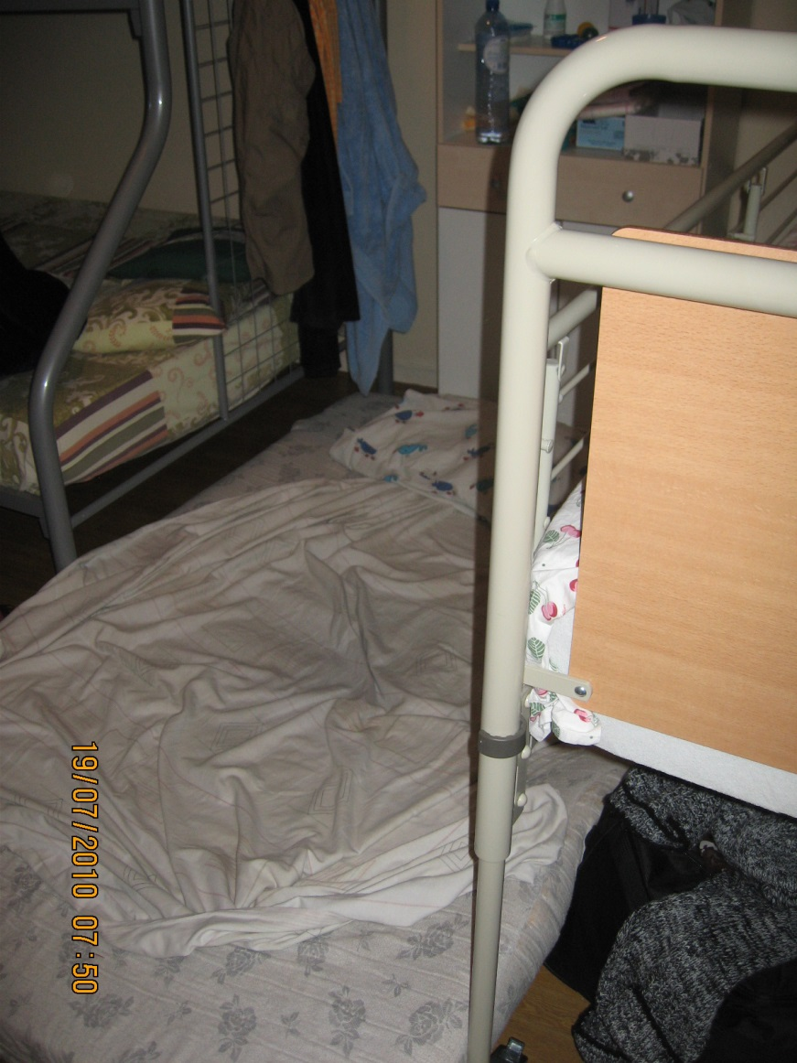
FILE “CHICOTTE” – July 2010

Slide 27
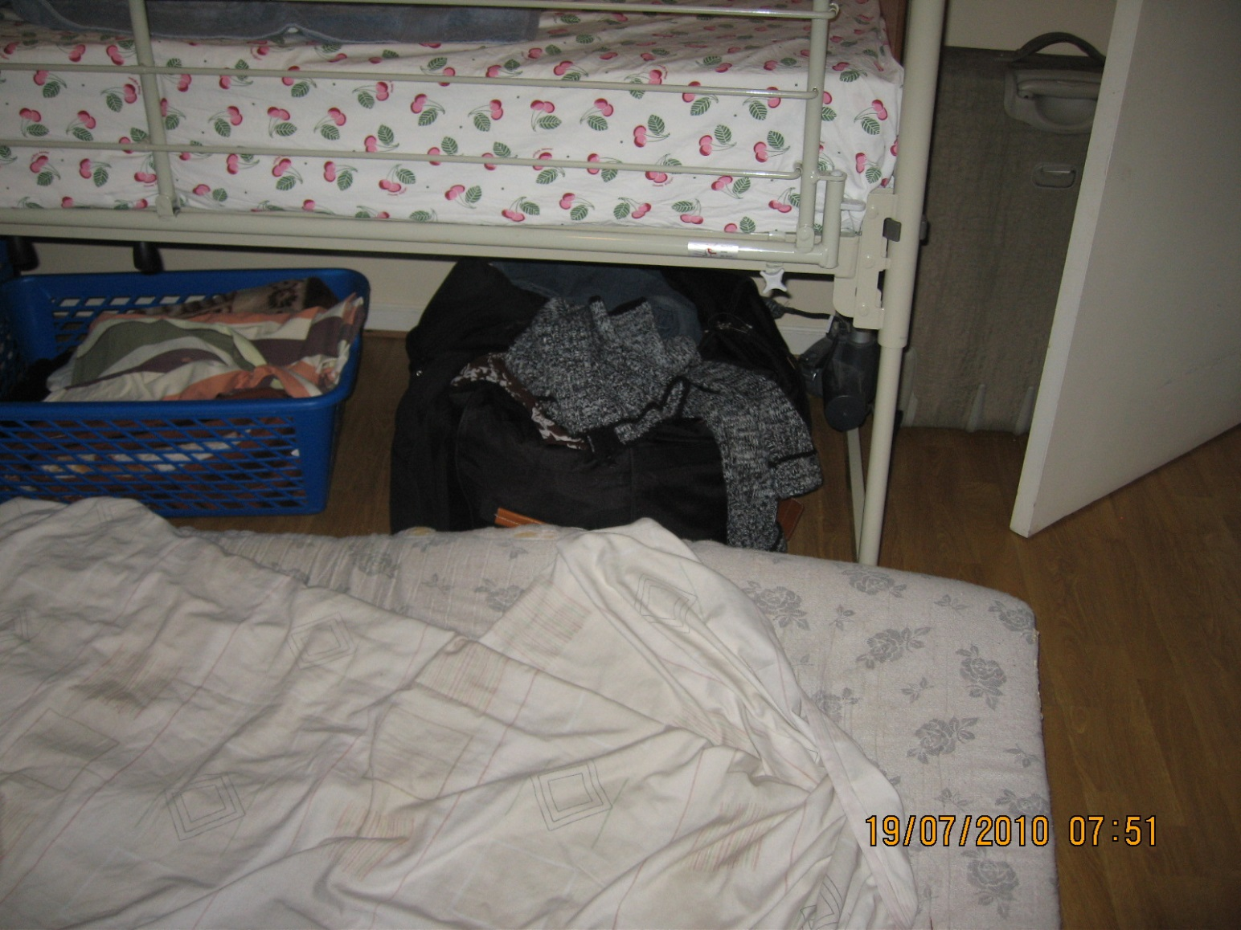
FILE “CHICOTTE” – July 2010

Slide 28
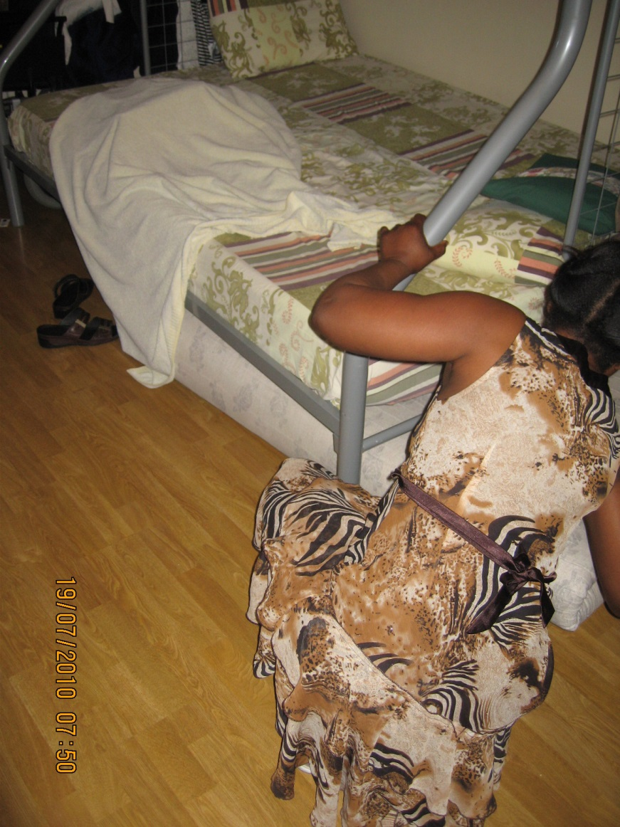

Slide 29
Social Inspectorate : investigating domestic work
Case
  Labour Inspector’s conclusion :
  Not just labour law offences
  but also trafficking in human beings by labour exploitation
  transferring a foreign national to Belgium with an eye to put her to work
  putting to work a foreign national with no legal residence permit and finding herself in a precarious situation
  violating various labour laws when employing this person
  have this person work during excessively long working periods
  serious underpayment of this worker
  salary payment in country of origin
  withholding of the worker’s passport
  worker accommodated at the workplace, in inhumane conditions
  Recruiting, transferring, accommodating a person with an aim to put this person to work in conditions contrary to human dignity
29
29
29

Slide 30
Social Inspectorate : investigating domestic work
Case
  Judgment Court First Instance Brussels 22 January 2013 : FACTS
  employer’s statements not credible
  argumentation built up by Labour Inspector fully accepted
  “The perpetrator has transferred and accommodated F. with an aim to put her to work in conditions contrary to human dignity”
  aggravating circumstances proven :
    abuse of F.’s vulnerable situation (illegal residence, precarious social situation), F. had no other choice than to submit to this abuse
  labour law violations proven
    undeclared work
    employing third country national without a work permit
    no insurance accidents at work
    non payment of wages
    no declaration to social security office
  victim was civil party in Court proceedings
30
30
30

Slide 31
Social Inspectorate : investigating domestic work
Case
  Judgment Court First Instance Brussels 22 January 2013 : SANCTIONS
  punishment should be severe (imprisonment + fine) because of :
    the extreme gravity of the facts
    the considerable harm afflicted on the victim
    the total denial of responsibility by the perpetrator
  exploiter
    imprisonment 2 years
    sentence deferred because no precedents and because the perpetrator is the mother of 2 children, one of which is severely disabled
    fine: 55,000 €
  victim
    52,383 € physical/material damages
    5,000 € moral damages
    2,500 € procedure damages
31
31
31

Slide 32
Social Inspectorate : investigating domestic work
Case
  Final Ruling Court of Appeal Brussels 12 May 2015 : SANCTIONS
  exploiter
    imprisonment 1 year
    sentence deferred
    fine: 11,000 € (deferred for 3 years)
  victim
    52,383 € physical/material damages
    5,000 € moral damages
    2,750 € procedure damages
32
32
32

Slide 33

Social Inspectorate : investigating domestic work
Case
information reached Social Inspectorate
timely investigation, good follow-up
profound questioning of victim, perpetrator and witnesses
photos taken
good cooperation inspectorate – police – prosecutor – referral centre
victim referral procedure properly started and pursued
skillful reporting to prosecutor
use of list of indicators (questioning + reporting)
prosecution + conviction for labour trafficking
victim civil party in criminal proceedings
damages awarded to victim
33

Slide 34
Thank you
Peter Van Hauwermeiren
peter.vanhauwermeiren@minsoc.fed.be
+32 497 51 61 10
34
34
34

Slide 35
The Belgian Social Inspectorate’s role in combating THB
Questions?
35
35
35
35

